Slide 1
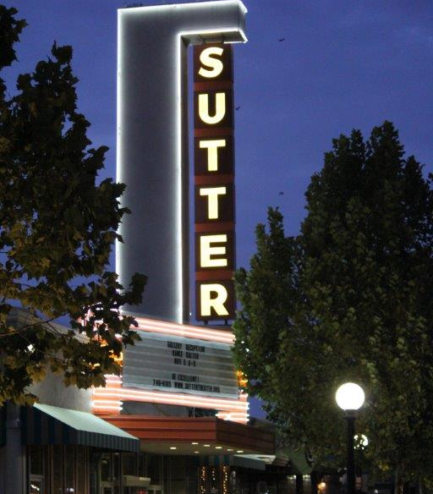
California Public Employees’ Retirement System (CalPERS)
Sutter County Pension Update

Slide 2
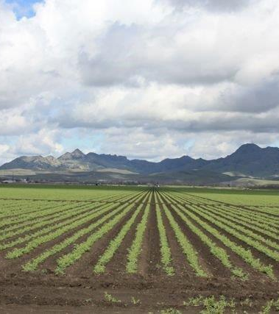

Introduction & Agenda
Status of Pension
Service-Delivery Impacts
Challenges
Possible Solutions

Slide 3
Status of Pension
Debt
Total Pension Liability = ($514 million)
Asset
Total Assets at CalPERS = $362 million
UAL
Total Unfunded Pension Liability = ($152 million)

Slide 4
Status of Pension

Slide 5
Status of Pension
Approximately 70% funded
3,000 total participants, 1,000 active
As a percentage of payroll: 2018-19 2020-21 2024-25
Miscellaneous - 26% 31% 36%
Safety - 39% 46% 52%
Budget - $17.5 M $22.3 M $28.6 M
UAL Payment - $10.7 M $13.7 M $18.9 M

Slide 6
Status of Pension

Slide 7
Status of Pension

Slide 8
Service-Delivery Impacts
Approximately $9 M to CalPERS in FY 2017-18 to pay County’s UAL
Other uses for $9 M if no UAL
Increased positions to enhance/maintain services
Capital projects
Replacement vehicles
Increased wages
Potential for Service-Delivery Insolvency
When a government is unable to provide services at the level and quality required to ensure the health, safety and welfare of the citizenry.

Slide 9
Challenges
Discount Rate Reduction – 7.5% to 7.0% over 3 years
Year 1 (2017-18) to 7.375%
Year 2 (2018-19) to 7.25%
Year 3 (2019-20) to 7.0%
CalPERS consultant concluded 6.0% over 10 years is reasonable

Slide 10

Challenges
Amortization Bases
CalPERS utilizes smoothing methodology
New amortization base each year
CalPERS’ reducing amortization periods from 30 to 20 years effective 2019

Slide 11
Possible Solutions
Marin County – State Supreme Court –
Appellate Court affirmed District Court ruling:
The defendant “…did not act impermissibly…to exclude specified items and categories of compensation from the calculation of pensions for current employees.”
Justice James Richman wrote in the Marin County ruling:
“While a public employee does have a ‘vested right’ to a pension, that right is only to a ‘reasonable’ pension — not an immutable entitlement to the most optimal formula of calculating the pension.”
Jody Morales, founder of Marin’s Citizens for Sustainable Pension Plans, said:
“The ultimate decision could be among the most important decisions made by the court this decade or even for this generation given the mind-boggling expansion of pension debt.”
SB 681 – Public Employees’ Retirement: contracting agencies: termination.
PEPRA

Slide 12
Possible Solutions
Continue/increase funding to PARS Irrevocable Trust
Employer and/or employee contributions
Develop pension prefunding policy to establish recommended minimum contributions each year.
Continue to Prepay UAL at beginning of each fiscal year
Continue to voice concerns to CalPERS
Maintain issue within Board Of Supervisors’ Top Ten Priorities

Slide 13

Presenting Staff
Nathan M. Black
Auditor-Controller
Nblack@co.sutter.ca.us
Steven M. Smith
Assistant County Administrator
Smsmith@co.sutter.ca.us

