Slide 1

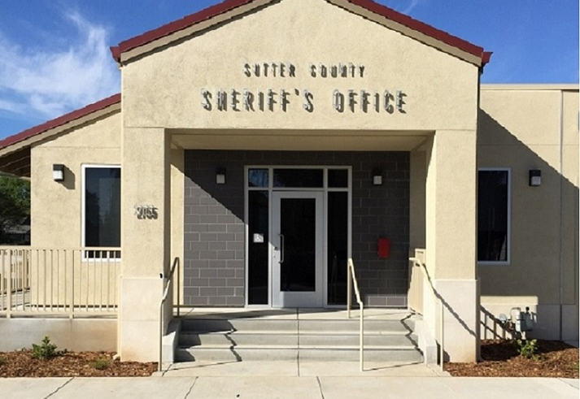
Live Oak
Law Enforcement services
December 1, 2025

Slide 2

Current Contract and Services Agreement
History of contract between SCSO and City of Live Oak
The current agreement is for a five-year term, effective July 1, 2024.
The prior agreement was effective November 1, 2007, and remained in place until the current agreement was executed. The current agreement appropriately aligns the cost with the level of services provided to the City of Live Oak.
The County and City have maintained a strong and collaborative partnership for law enforcement services since December 1979.

Slide 3
Costs for Law Enforcement Services
FY2025-26 Sheriff Live Oak Division Budgeted Cost- Not Actual Cost:
FY2025-26 Sheriff Live Oak Division Staffing:
FY2025-26 Budgeted Salary and Benefits | $ 2,714,169
FY2025-26 Budgeted Services and Supplies | $ 612,990
Total Live Oak Law Enforcement FY2025-26 Budget | $ 3,327,159
Live Oak City FY2025-26 Budgeted Share of Cost | $ 2,995,873
Sutter County FY2025-26 Budgeted Share of Cost | $ 331,286
Sheriff Live Oak Division Total Positions | 13.2
Deputy Sheriff & Detective | 8
Sheriff’s Patrol Sergeant | 1
Patrol Lieutenant | 1
Public Safety Dispatcher | 2.5
Supervising Public Safety Dispatcher | 0.5
Sheriff Communications Coordinator | 0.2

Slide 4
Additional Services Provided
No cost for large scale incidents and high-profile investigations (tactical issues, vehicle fatalities, missing persons).
No cost for specialized services such as SED, Search & Rescue. This includes equipment.
No cost for additional detective services.
No cost for new deputy startup equipment such as vest, handcuffs, gun, rifle, duty belt, flashlight, portable radio, etc.
No cost for recruitment, HR, payroll, background, manage workers compensation claims, new hire medical, and psychological services.
No cost for Evidence Processing/Evidence Technician time.
No cost to handle matters such as scheduling & attendance, performance evaluations, labor relations and negotiations, grievances and discipline issues, citizen complaints, internal affairs.
No cost to apply for various State Grant funds to conduct DUI Check points, Street Racing and Sideshow, Click It or Ticket, School Safety Presentations, etc.

Slide 5
Staffing and Scheduling Overview
Live Oak | MON | TUES | WED | THU | FRI | SAT | SUN | MON | TUES | WED | THU | FRI | SAT | SUN
Lieutenant | x | 10 | 10 | 10 | 10 | x | x | x | 10 | 10 | 10 | 10 | x | x
Sergeant | 10 | 10 | 10 | 10 | x | x | x | 10 | 10 | 10 | 10 | x | x | x
B-Side
Deputy #1 | 12 | 12 | x | x | x | x | 12 | 12 | 12 | 12 | x | x | x | 12
Deputy #2 (Vacant) | 12 | 12 | x | x | x | x | 12 | 12 | 12 | 12 | x | x | x | 12
Deputy #3 | 12 | 12 | x | x | x | x | 12 | 12 | 12 | 12 | x | x | x | 12
A-Side
Deputy #4 | x | x | 12 | 12 | 12 | 12 | x | x | x | x | 12 | 12 | 12 | x
Deputy #5 | x | x | 12 | 12 | V | V | x | x | x | x | 12 | 12 | 12 | x
Deputy #6 | x | x | 12 | 12 | 12 | 12 | x | x | x | x | 12 | 12 | 12 | x
Traffic
Deputy #7 | 10 | 10 | 10 | 10 | x | x | x | 10 | 10 | 10 | 10 | x | x | x
Detective
Detective position | 10 | 10 | 10 | 10 | x | x | x | 10 | 10 | 10 | 10 | x | x | x

Slide 6

Employee Leave Factors
Trainings:
Average from 150 to 200 hours for each deputy annually
Paid leave:
Holiday leave of 112 hours annually
Vacation leave, 2-4 weeks annually
Sick leave of 2.5 weeks annually
Compensatory up to 4 weeks annually
FMLA leave
Up to 480 hours and/or long-term leave of absence (Care for family/Maternity)
Military leave:
30 days per year

Slide 7

Traffic Enforcement Data
2024
Traffic accidents: 93
Traffic citations: 559
2025
(January-October)
Traffic accidents: 98
Traffic citations: 398

Slide 8
Detective Summary
Workload Summary:
Search Warrants:
63
Arrest Warrants:
10
Reports Written:
104
Felony Arrests:
20
MDIs:
25
Cases include, shootings, child death, sexual assaults, lottery fraud, weapons violations, domestic violence, assault with deadly weapons cases, gang and narcotic cases.

Slide 9
Calls for Service-Call Types
Priority 1 calls are generally 911 calls and immediate response calls with life-threatening circumstances.
Priority 2 calls are generally immediate response calls with property, threats, or potential of escalation.
Priority 3 calls are non-immediate response calls such as counter calls.
Priority 4 calls are generally routine response calls such as traffic stops and civil problems.

Slide 10
Calls For Service Data
Total CFS: 8,071

Slide 11
Calls For Service Data
Total CFS: 2,636
July 1, 2025- October 31, 2025

Slide 12
Sutter County Sheriff’s Office Organization Assessment and Staffing Study
“We also concluded that the SCSO provides an effective level of patrol resources and that service levels in the City of Live Oak are consistent with or better than those provided countywide. For instance, the SCSO typically allocates at least one deputy per shift to cover Live Oak beats.”
“For instance, the data shows that the City of Live Oak accounts for an average of 25% of the total calls for service received by the dispatch center. This is consistent with the City’s size, which represents 32% of the Sutter County population excluding the City of Yuba City.”
Sutter County Sheriff’s Office Organization Assessment and Staffing Study, 2022

Slide 13
There are no Definitive Staffing Level Models
The Live Oak population was 9,106 at the 2020 census.
Live Oak, 2012 Municipal Services Review- “According to U.S. Department of Justice figures, for municipal police departments serving a population of 1,000 or more, the average ratio of full-time officers per 1,000 residents was 2.6.” Municipal Service agreement review 4.0-16
  23 officers
FBI data through 2024 shows an average recommendation of 3.51 officers per 1000 persons https://cde.ucr.cjis.gov/LATEST/webapp/#/pages/le/pe
  31 officers
A 2020 University of North Florida (UNF) study on manpower analysis determined the average officer to resident ratio based upon geographical regions of the United States. The West had 1.6 officers per 1,000 residents (Vose et al.,2020). https://www.fdle.state.fl.us/getContentAsset/e79e476e-ec2b-45b3-b658-07a29dd30499/73aabf56-e6e5-4330-95a3-5f2a270a1d2b/Mahoney-Jeff-paper.pdf?language=en
  14.4 officers

Slide 14
What Does the California Constitution Say
California Constitution Article I - Declaration of Rights, Section 1.
All people are by nature free and independent and have inalienable rights. Among these are enjoying and defending life and liberty, acquiring, possessing, and protecting property, and pursuing and obtaining safety, happiness, and privacy.
Incorporated cities typically have two primary options for providing law enforcement, as outlined in state law:
Establish a municipal police department: Create and fund its own police force, appointing a local police chief to manage the department.
Contract with the county sheriff's office: A city can contract with the county sheriff to provide law enforcement services within its city limits. This is a common and often more cost-effective option, particularly for smaller cities.

Slide 15
What Does the Government Code Say
Gov. Code 54980(c)
“Municipal services or functions” includes, but is not limited to, firefighting, police, ambulance, utility services, and the improvement, maintenance, repair, and operation of streets and highways.
Gov. Code 54981. Contracts for municipal services
The legislative body of any local agency may contract with any other local agency for the performance by the latter of municipal services or functions within the territory of the former.

Slide 16
Notice to Terminate Existing Contract
On Friday September 26th, 2025, the Live Oak City Manager notified county CAO of the city manager’s intent to make a recommendation to the council to terminate both fire and law contracts due to financial restraints.
The City Council voted (4/5) to terminate these contracts at their meeting on October 1st, 2025.
The county verified this was the city’s intent on October 2nd and the city put out a media release advising the community on October 3rd, 2025.
The same day, the county put out a media statement acknowledging the city’s notice to terminate the contract.

Slide 17
What That Means for SCSO
SCSO is open to renegotiating the contract for services, considering CFS, appropriate staffing levels, employee safety, and the needs of the community.
In the event an agreement is not reached with SCSO, the City of Live Oak will receive responses to essential CFS such as felony assaults, missing persons and domestic violence type cases.
Response times will increase due to deputies responding from unincorporated areas of the county.
A method for handling all other CFS will need to be established.
Traffic accidents and traffic related complaints will be deferred to CHP.

Slide 18
Legal Obligations and Levels of Service
Gov. Code 26605
Notwithstanding any other provision of law, except in counties in which the sheriff, as of July 1, 1993, is not in charge of and the sole and exclusive authority to keep the county jail and the prisoners in it, the sheriff shall take charge of and be the sole and exclusive authority to keep the county jail and the prisoners in it including persons confined to the county jail pursuant to subdivision (b) of Section 3454 of the Penal Code for a violation of the terms and conditions of their post release community supervision, except for work furlough facilities where by county ordinance the work furlough administrator is someone other than the sheriff.

Slide 19
Legal Obligations and Levels of Service
Gov. Code 26600
The sheriff shall preserve peace, and to accomplish this object may sponsor, supervise, or participate in any project of crime prevention, rehabilitation of persons previously convicted of crime, or the suppression of delinquency.
Gov. Code 26601
Arrests - The sheriff shall arrest and take before the nearest magistrate for examination all persons who attempt to commit or who have committed a public offense.

Slide 20
Next Steps for SCSO
Unless a new contract is agreed upon, SCSO will begin the process of scaling back resources over the next year to ensure a smooth transition.
SCSO will need to work with the CAO’s Office to absorb positions, or not fill positions through attrition, to ensure increases to the county budget can be sustained.
Resources that are removed or reallocated cannot be stood back up overnight once the contract period concludes. There are recruitment issues, equipment issues, and training that all needs ample time to reinstitute some levels of service.

Slide 21
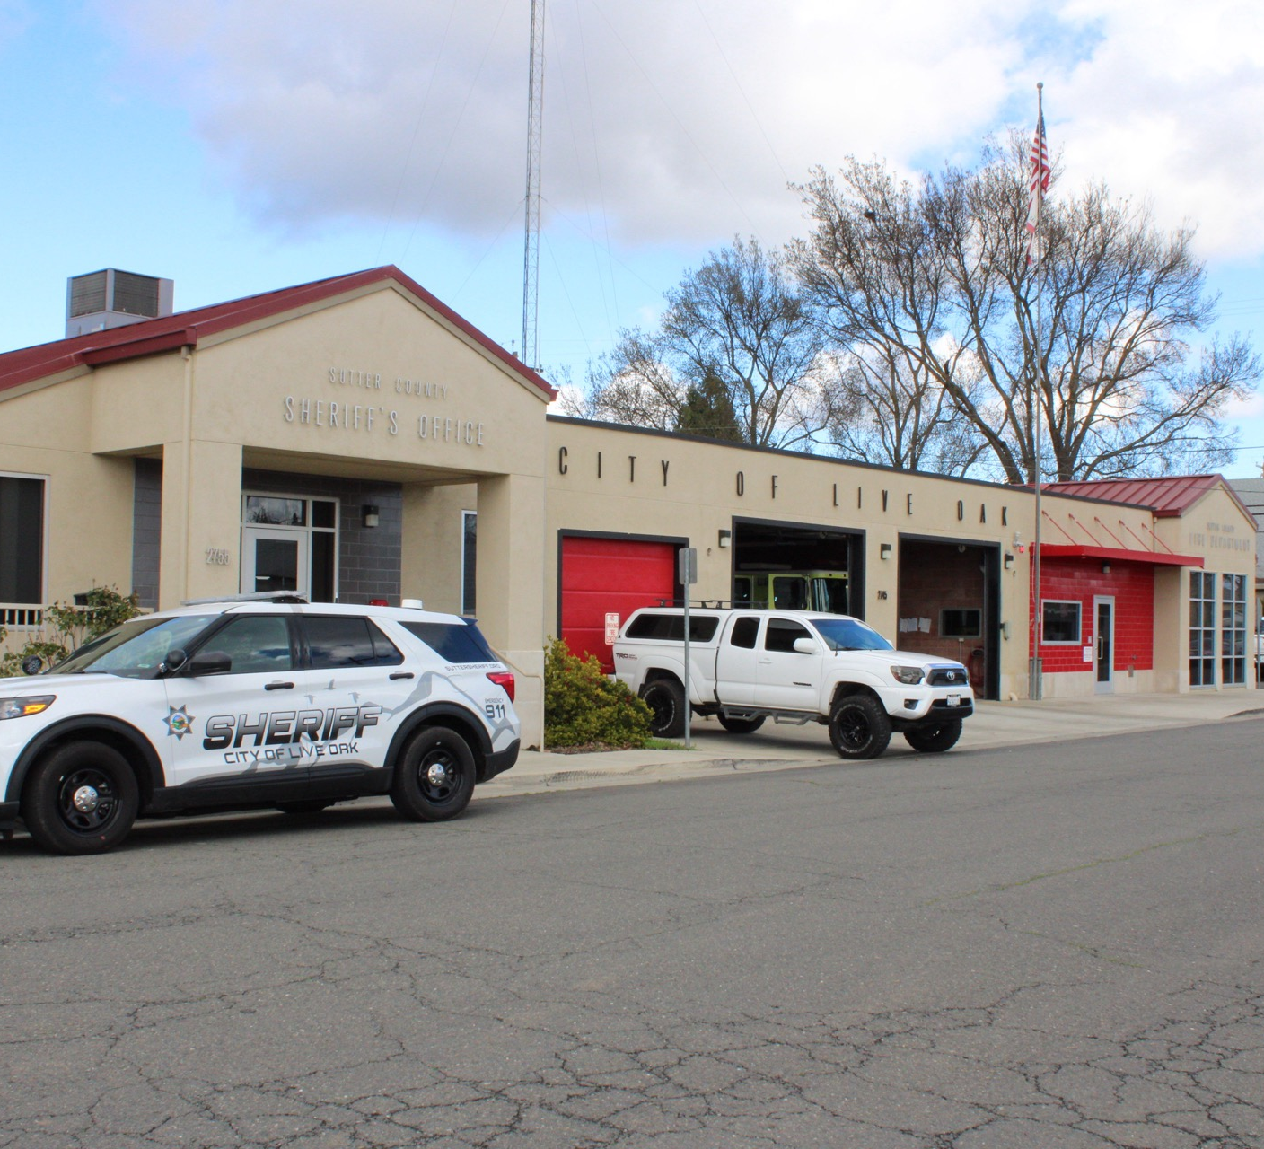
THANK YOU
Sutter County Sheriff’s Office
530-822-7312
Suttersheriff.org

