Slide 1


The Sutter County Conversation
Keeping Our Region Safe and Self- Reliant
Winter 2026

Slide 2



Community Conversation Goals
Learn About County Challenges.
To maintain safety, services, and quality of life countywide, Sutter County is seeking feedback from our community on vital safety and quality of life issues
Provide Feedback.
Sutter County is listening to residents about their local service priorities - let us know what you care about most today!
Stay Informed.
Your feedback will help inform next steps at the County level.

Slide 3
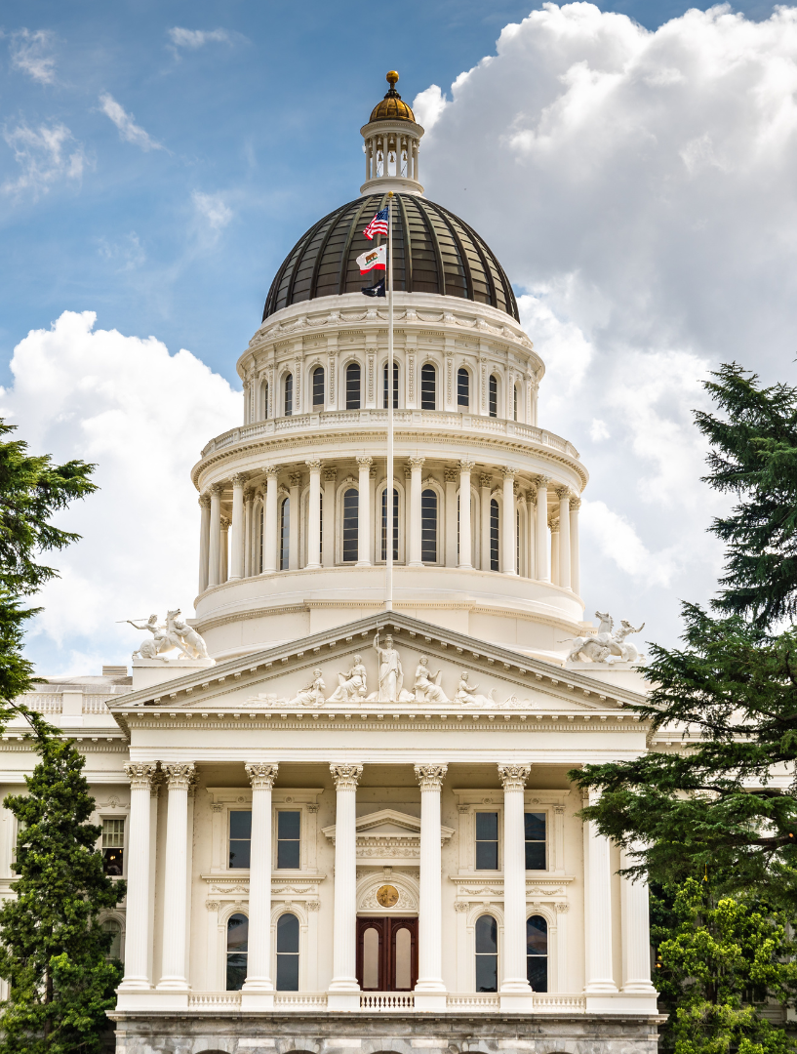
State Takeaways Threaten Regional Safety
Sutter County faces growing public safety demands:
Safe streets
Safe neighborhoods
Safety from growing fire threats
State and Federal actions continue to take local funding
Our region cannot rely on outside governments to keep us safe – we must rely on ourselves.

Slide 4
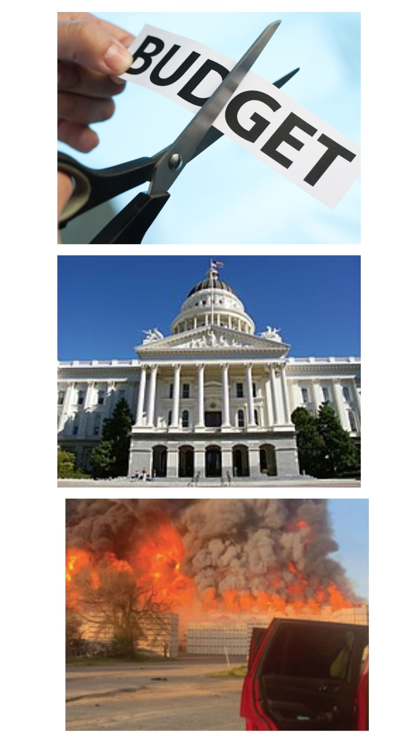
Why This Conversation Matters
The County has already made significant budget reductions.
With State and Federal takeaways of regular and safety funds, more budget cuts are inevitable.
Sutter County and cites like Yuba City and Live Oak depend on one another for mutual aid – County budget cuts impact our ability to help each other.
Before future decisions and service cuts are made, community input is crucial.

Slide 5
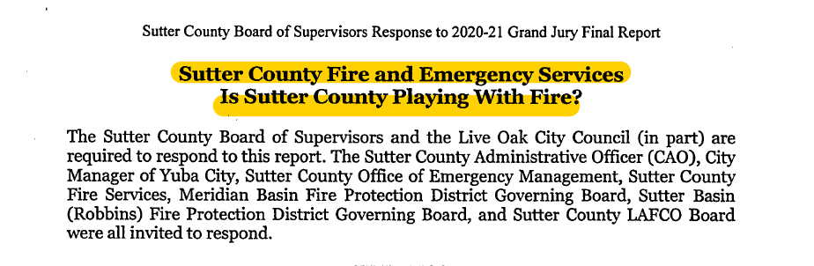
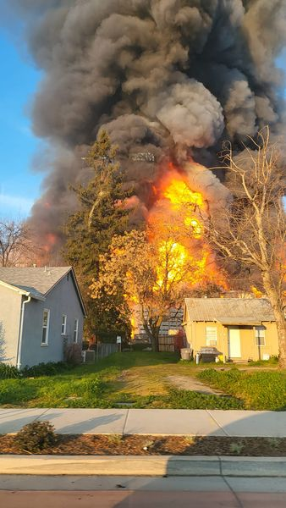
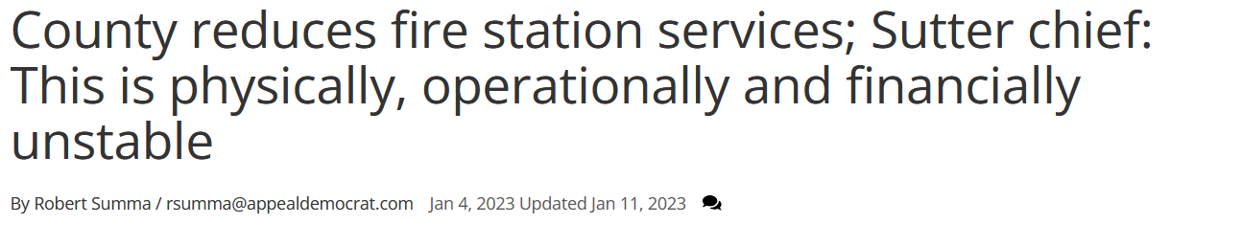
State Takeaways Increase Pressure On Strained County Fire & Emergency Services
Increased wildfire risk
Aging equipment and facilities
Staffing and retention challenges
Rising emergency response needs
A recent Grand Jury Report confirmed these needs. Since that time, fire safety budgets have been cut due to financial constraints - and more takeaways are coming.

Slide 6
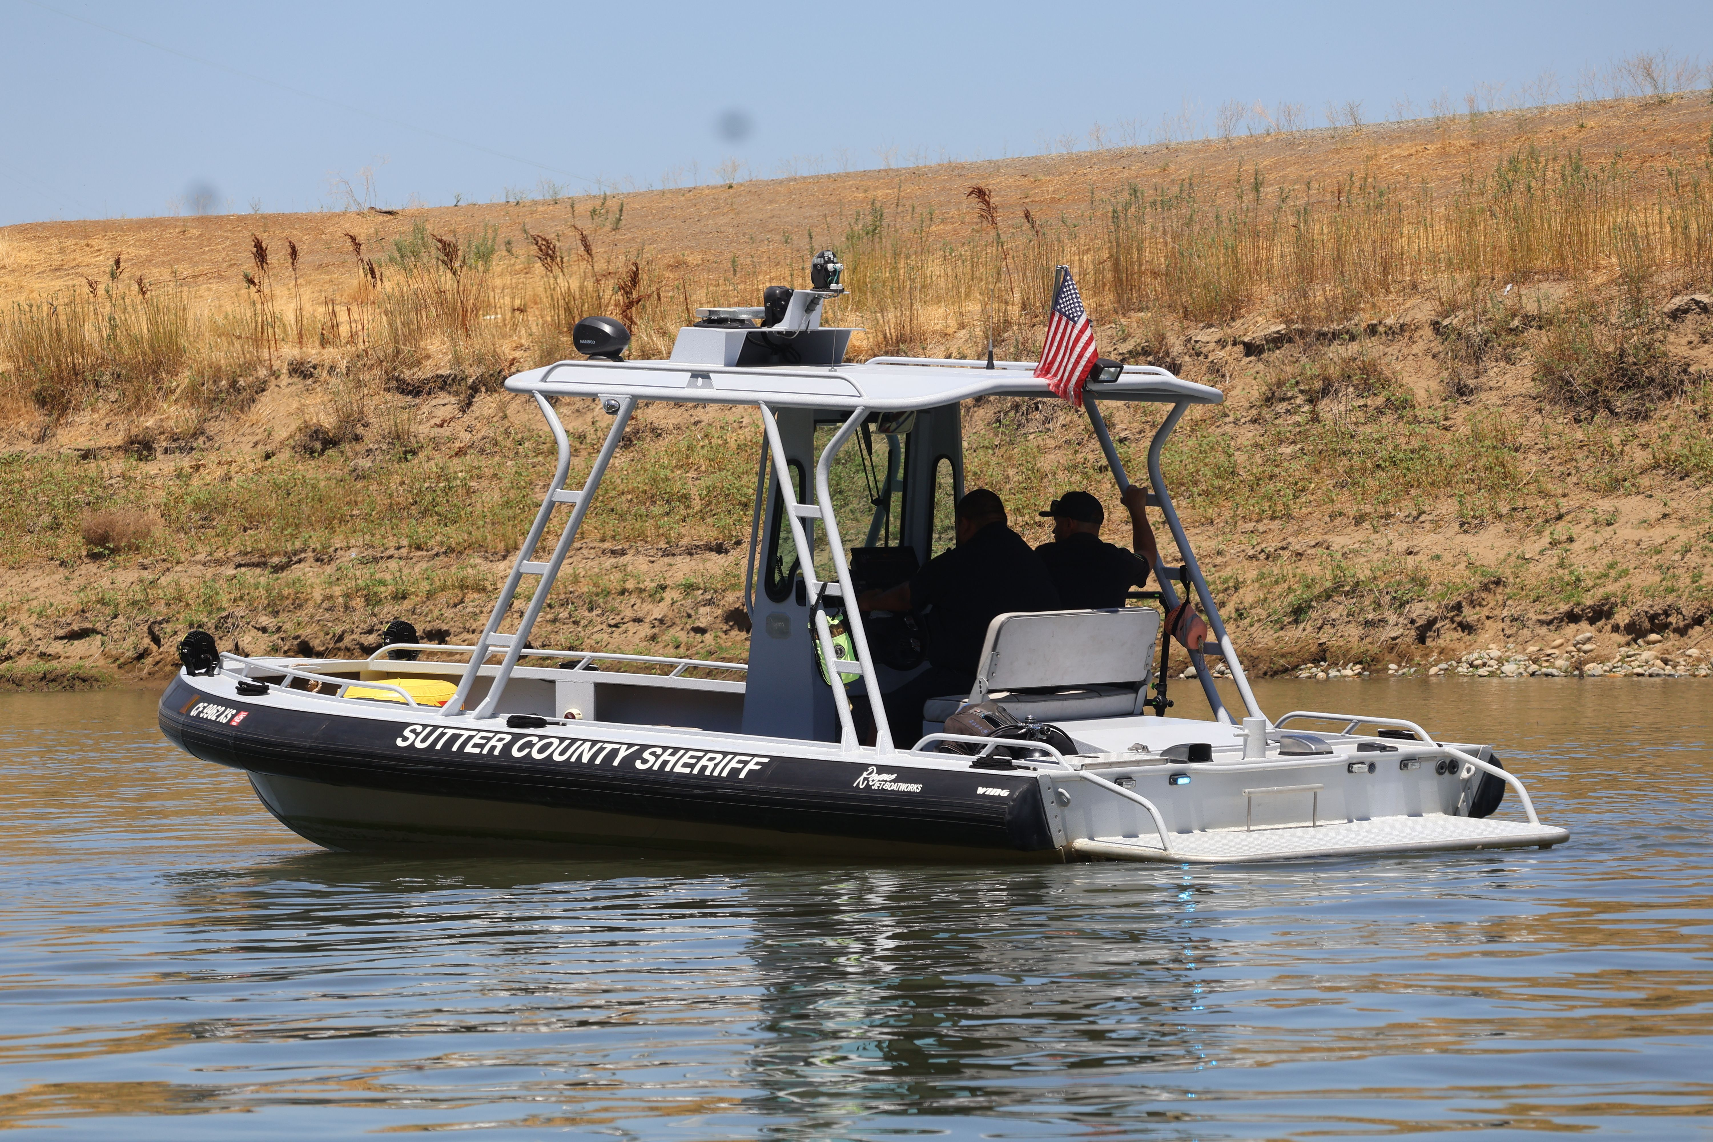
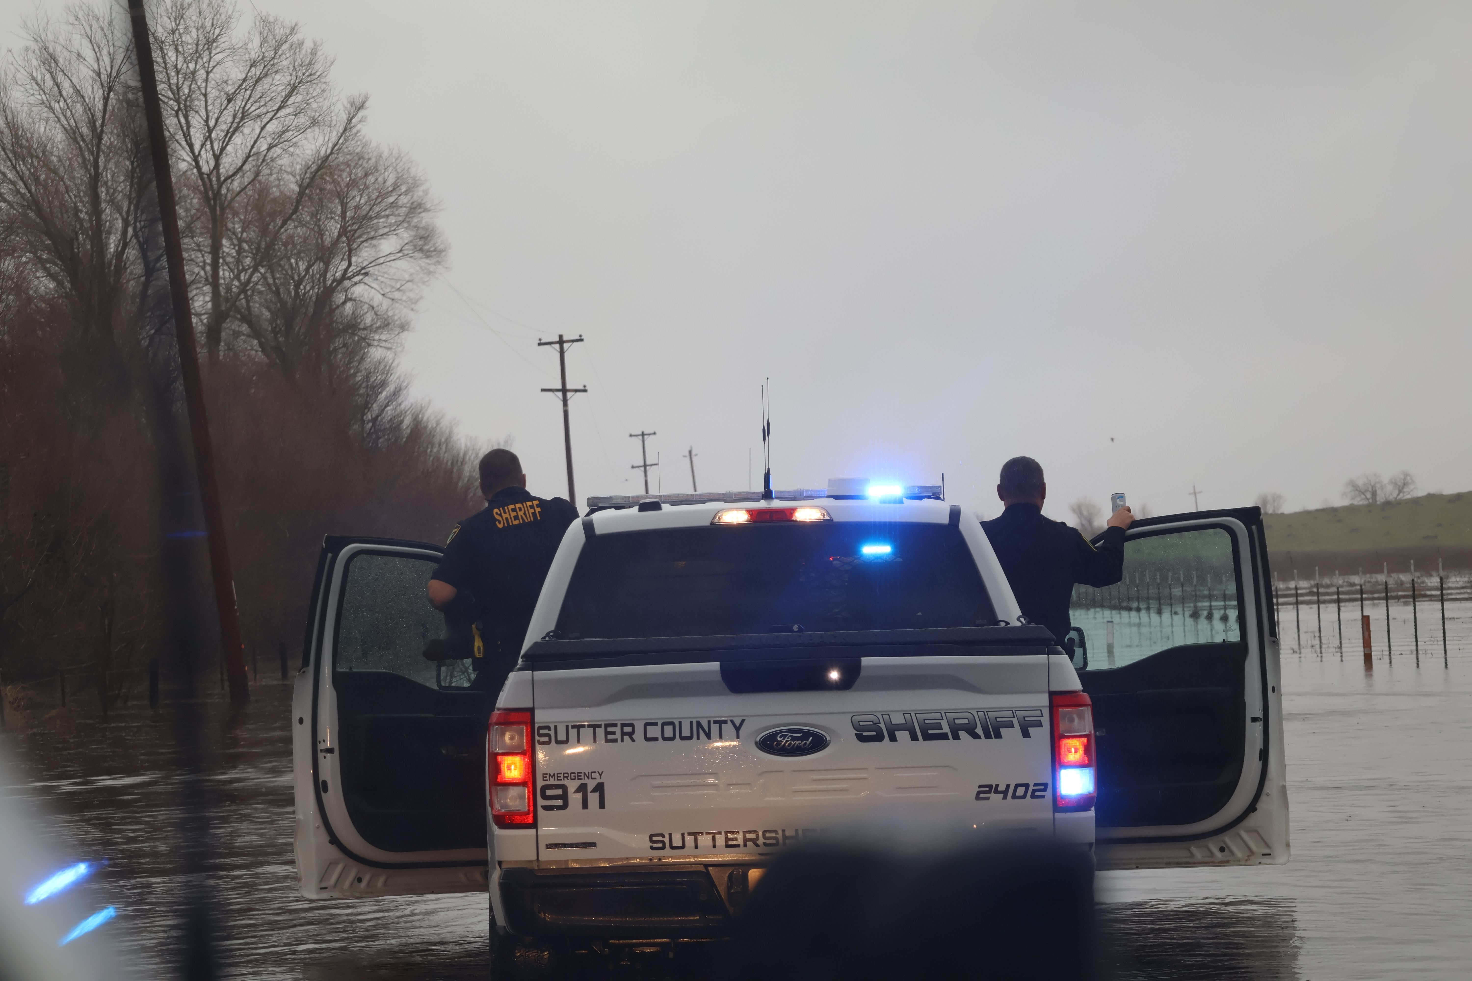
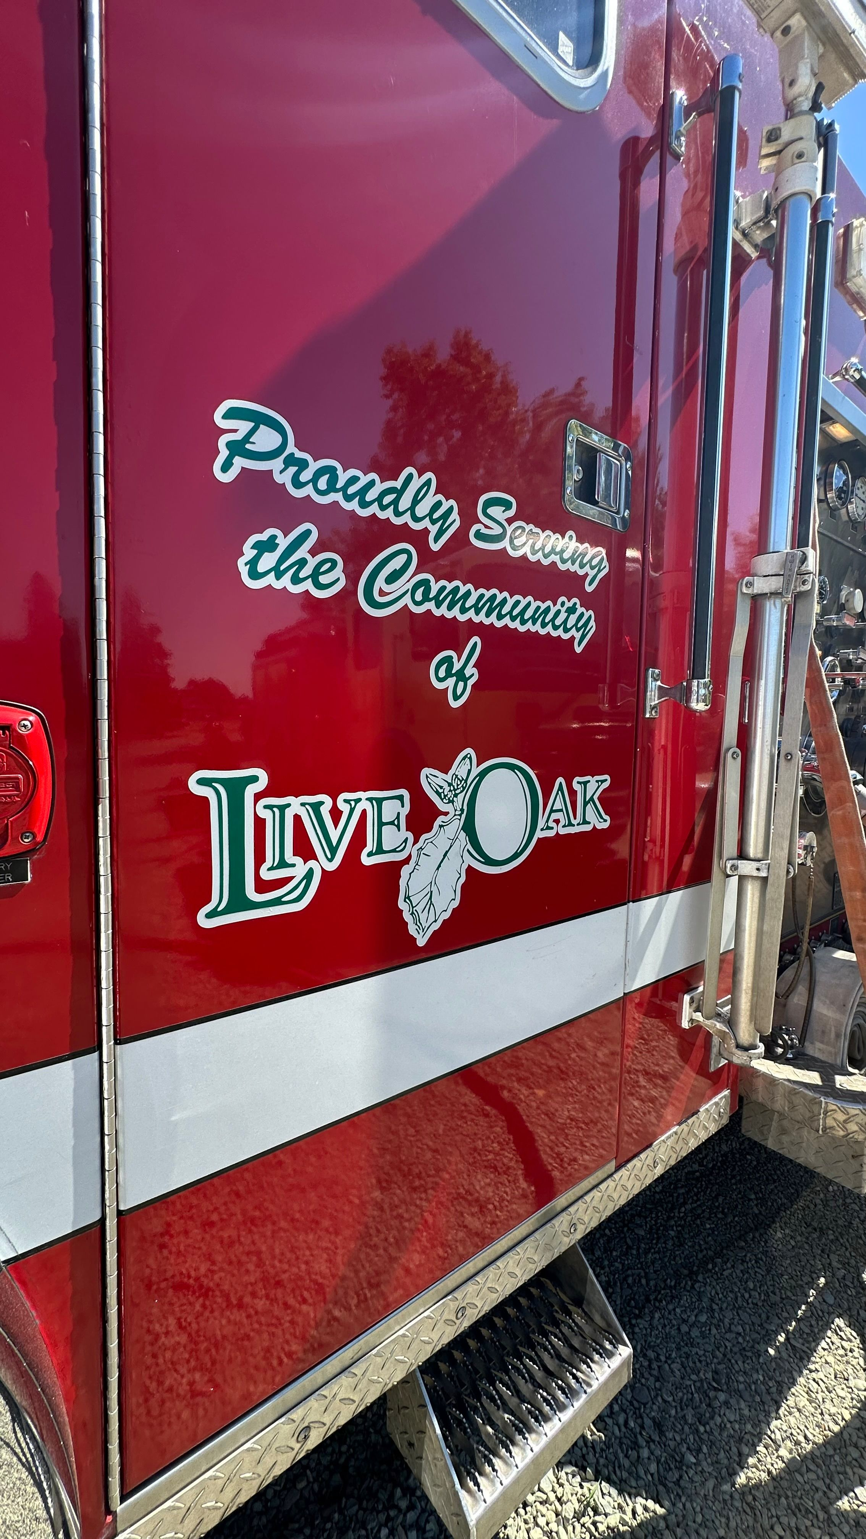
State Actions Impact Regional Public Safety
Rural areas significantly affected by safety funding issues
At times, only three deputies are on patrol for 600 square miles.
Public safety crosses jurisdictional lines
Live Oak relies on County fire services
Yuba City and the County depend on each other’s mutual aid for fire and police.

Slide 7
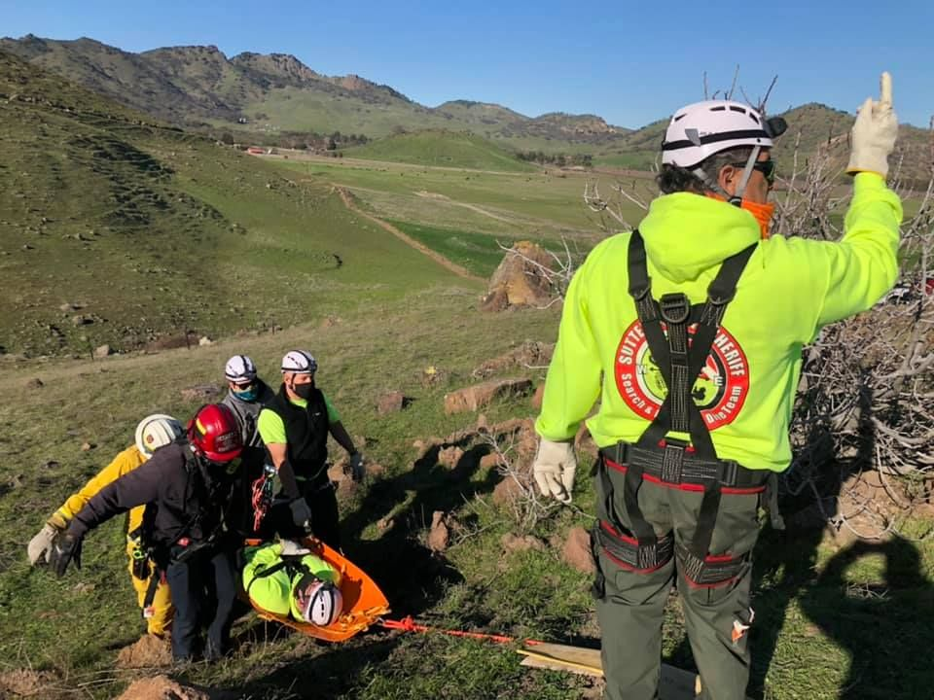
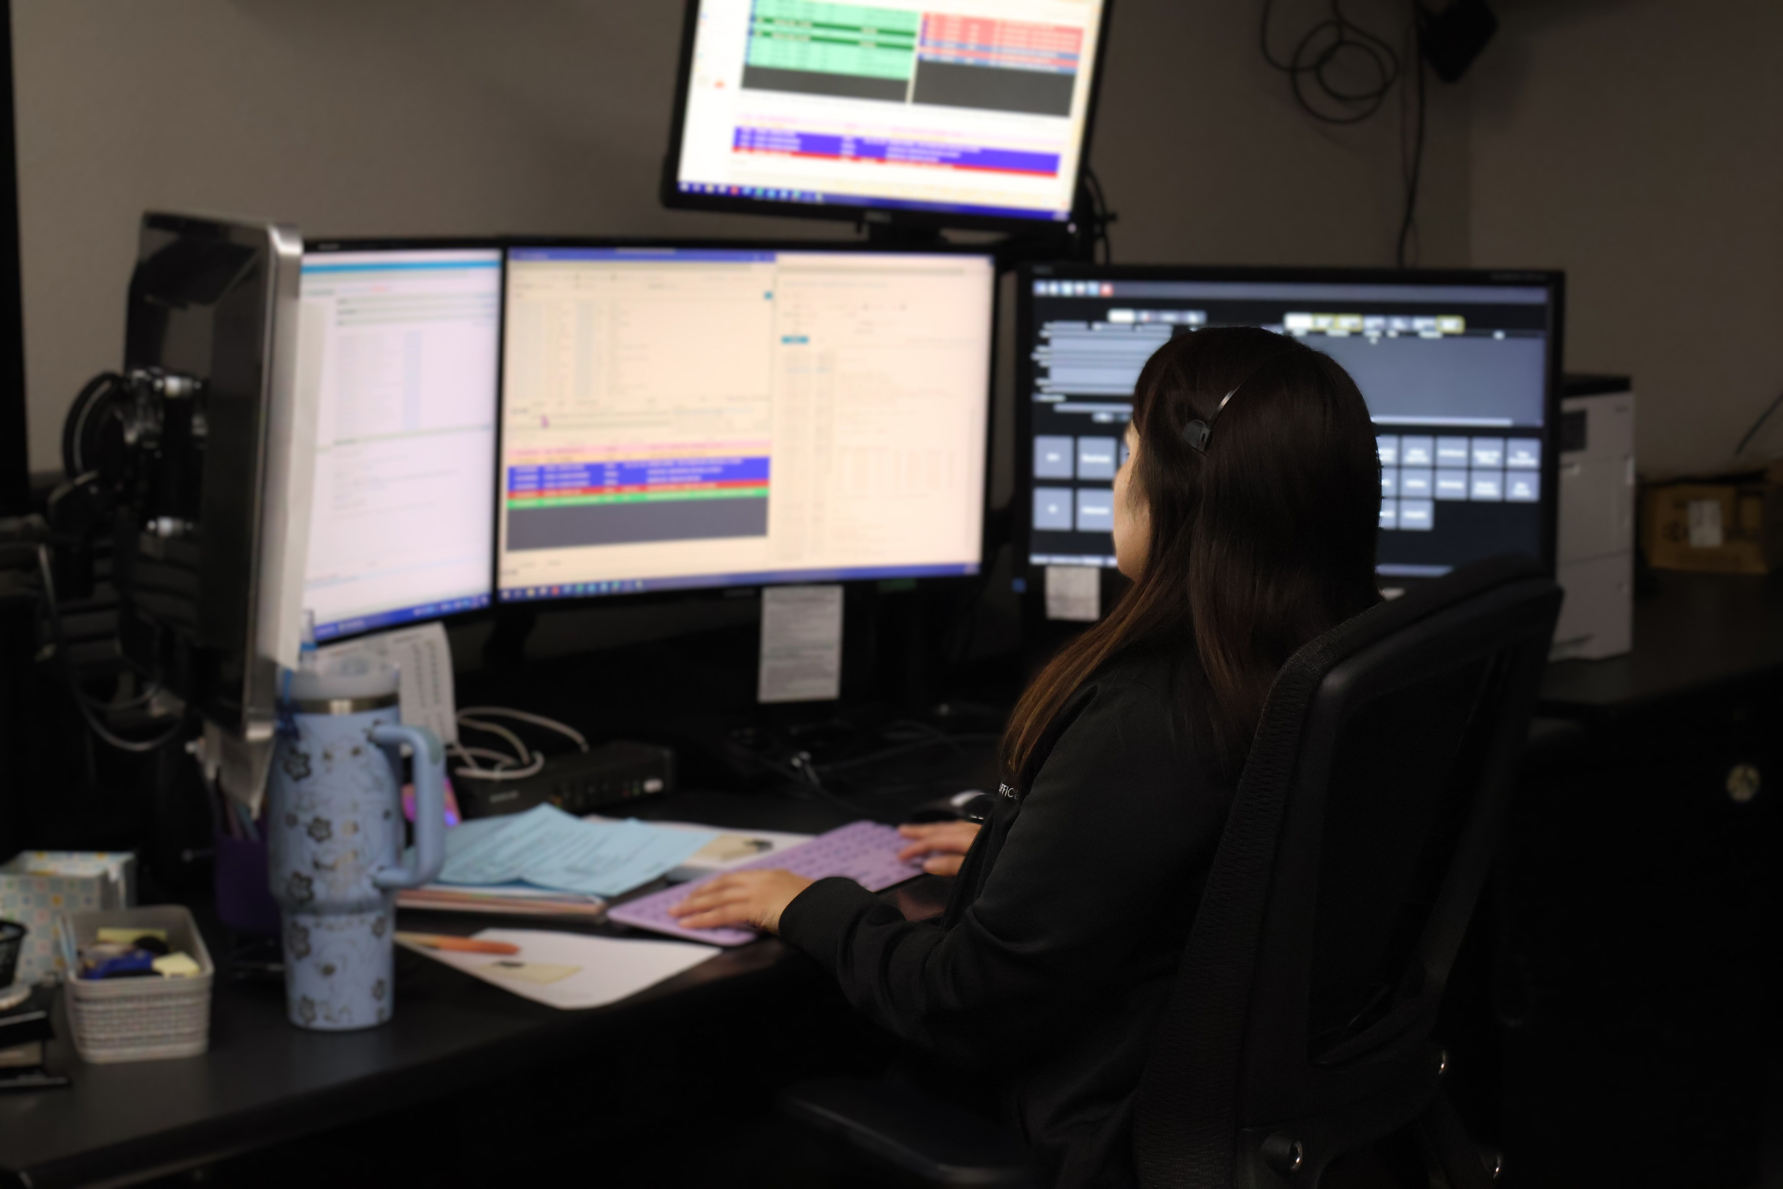
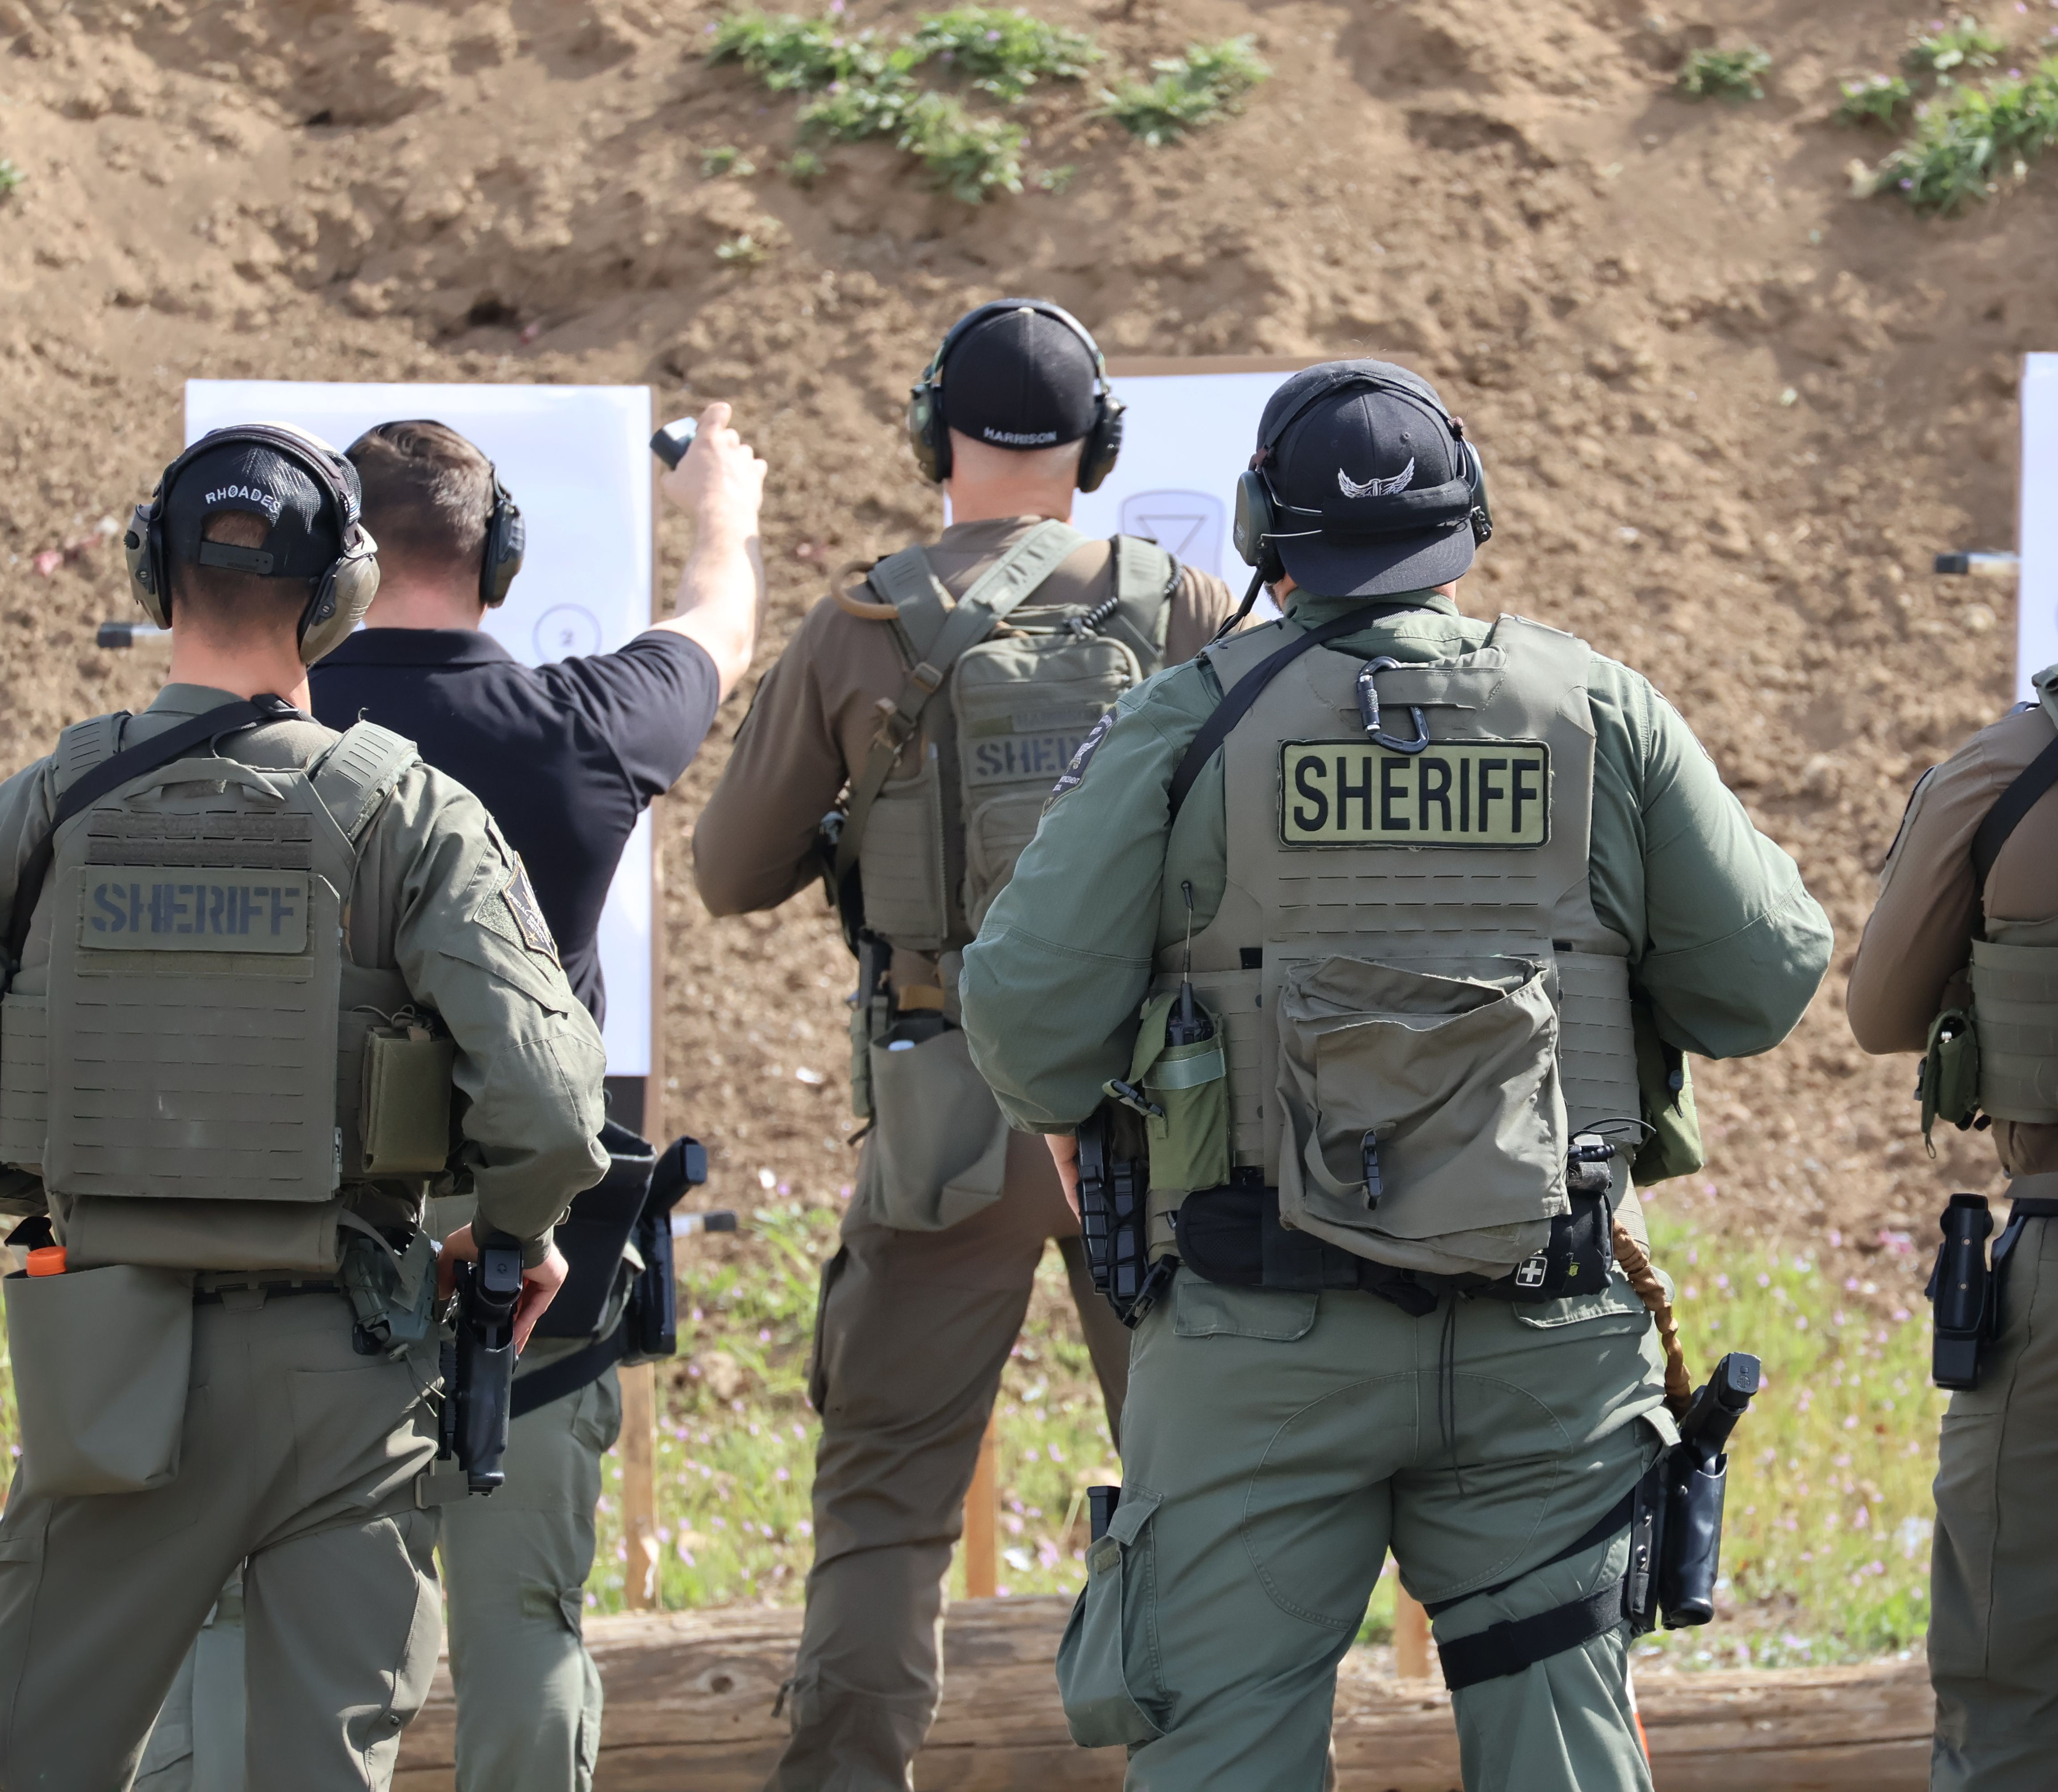
Our Regional Public Safety Is Threatened By:
Fewer deputies than recommended
Large patrol areas, especially in rural regions
Longer response times to 911 sheriff/police calls
Limited ability to improve coverage

Slide 8
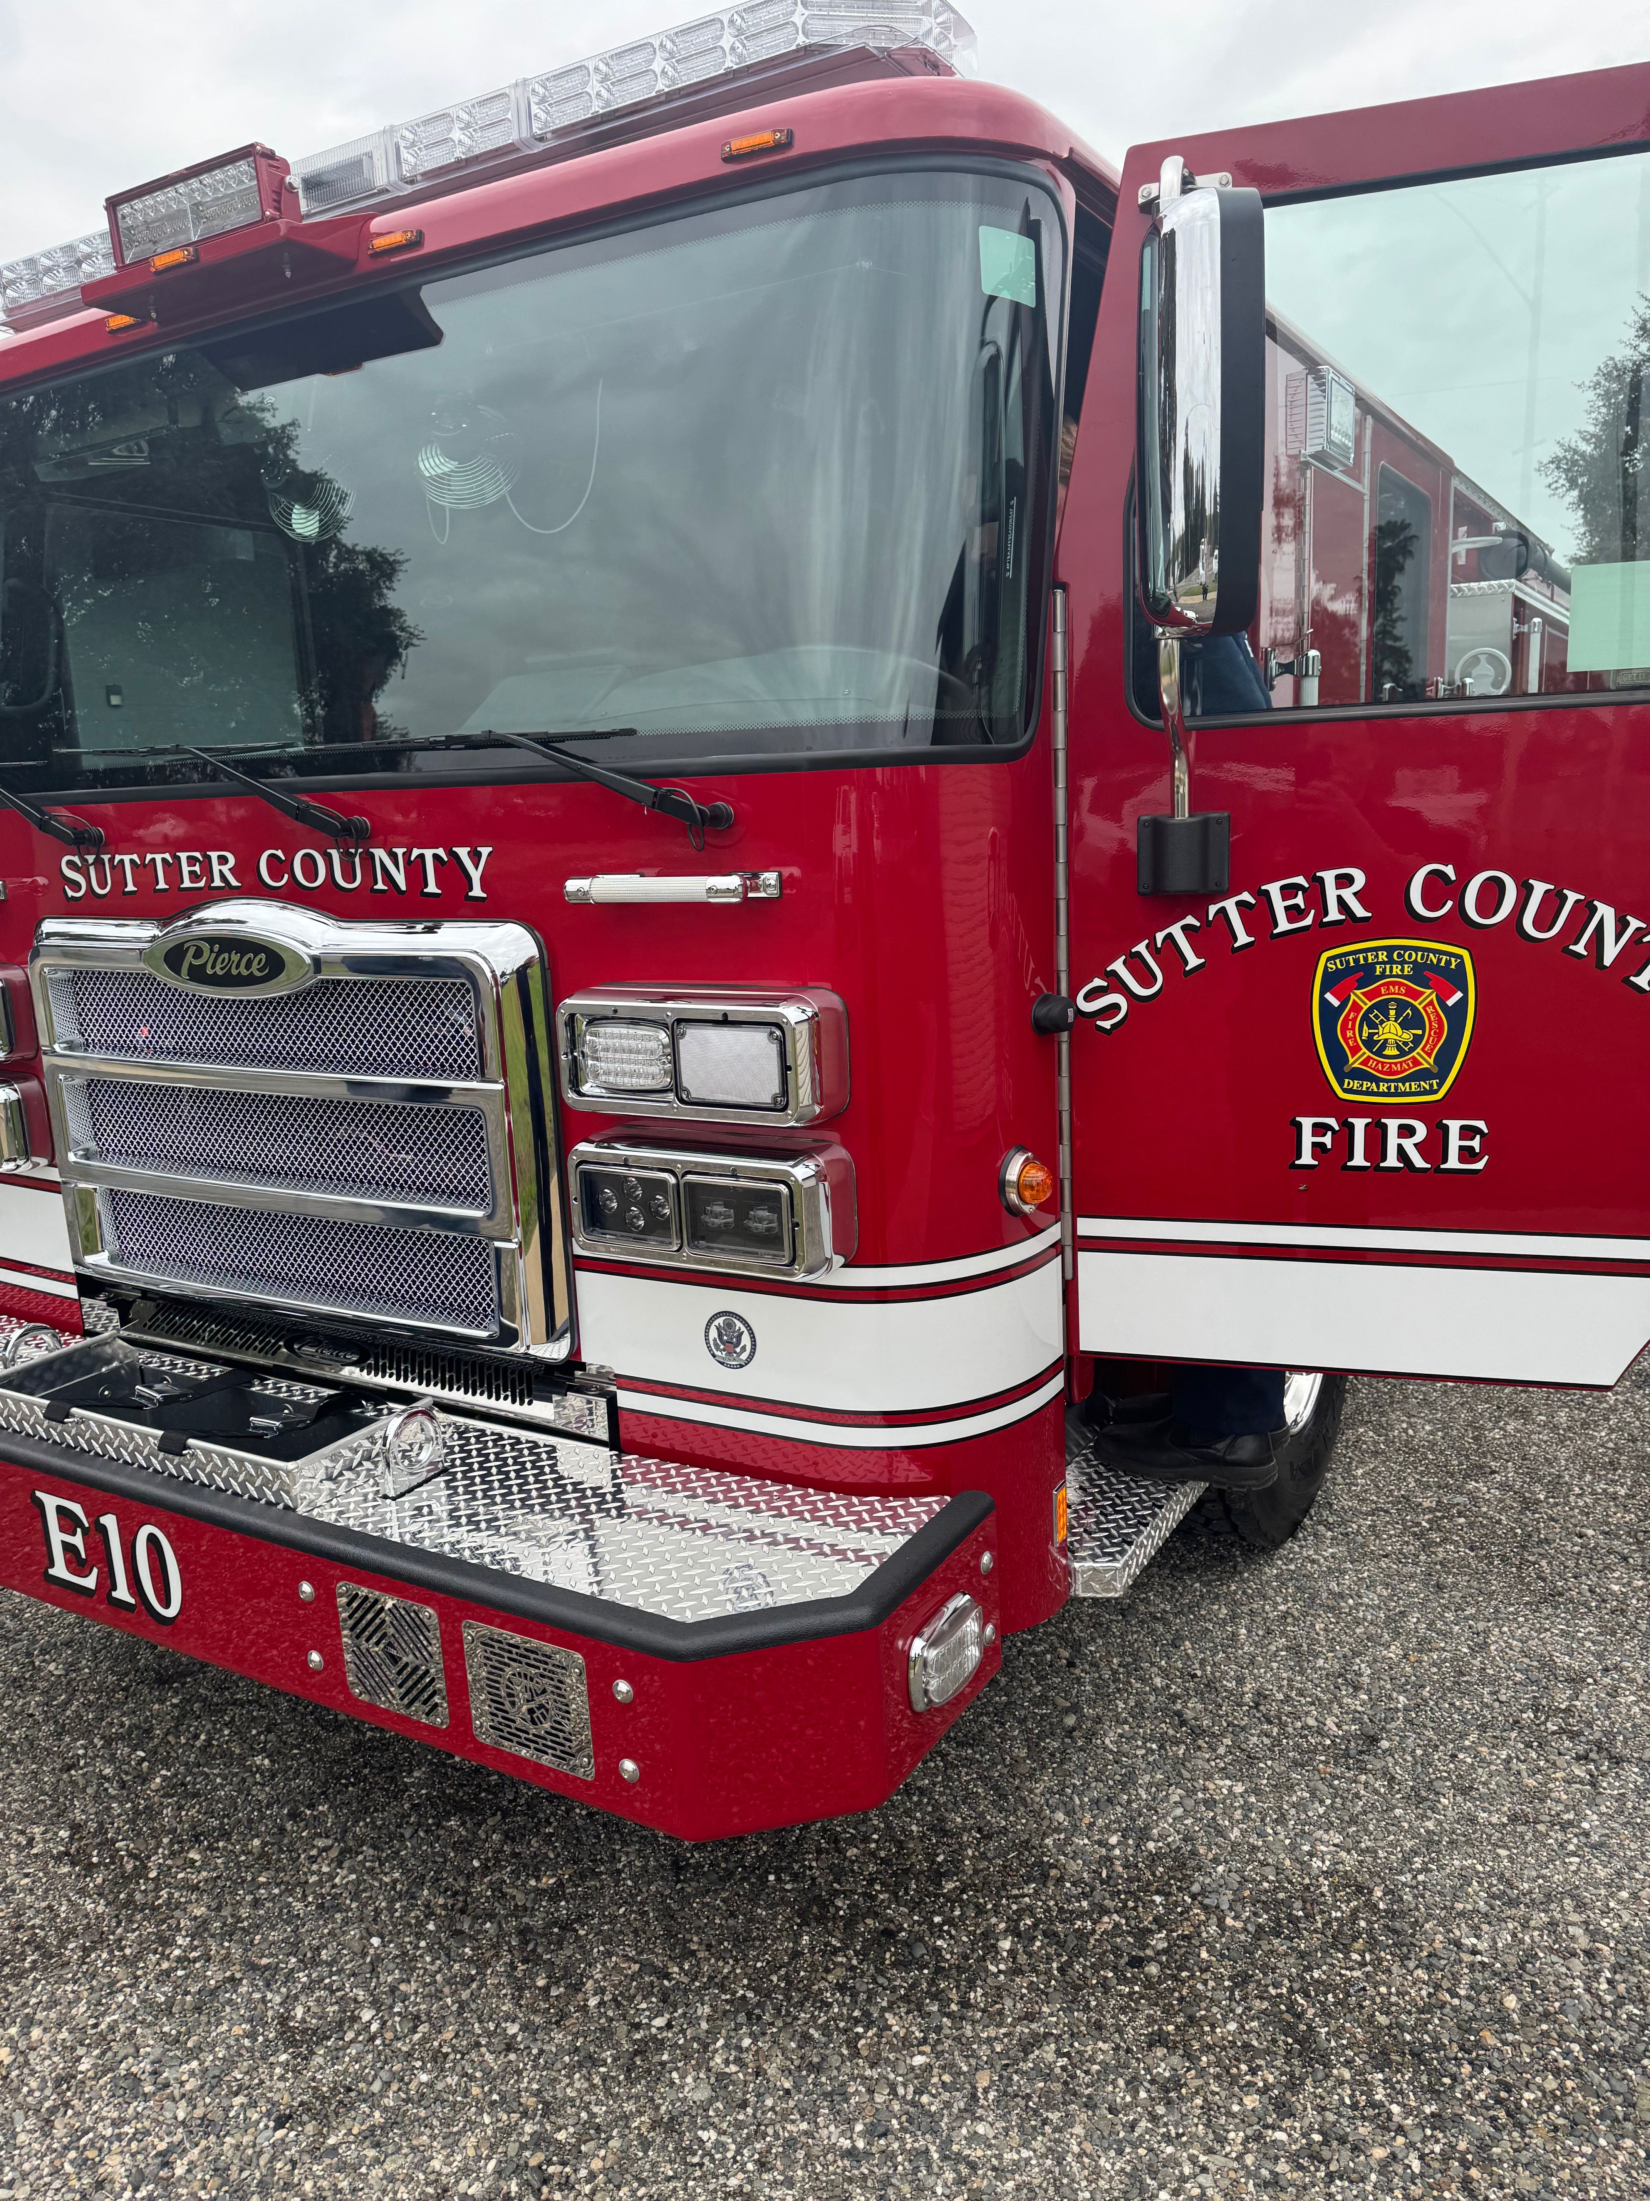
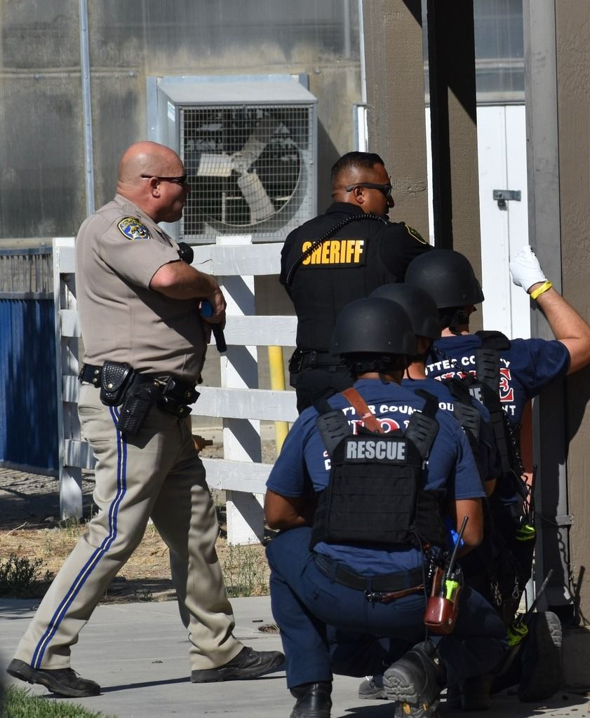
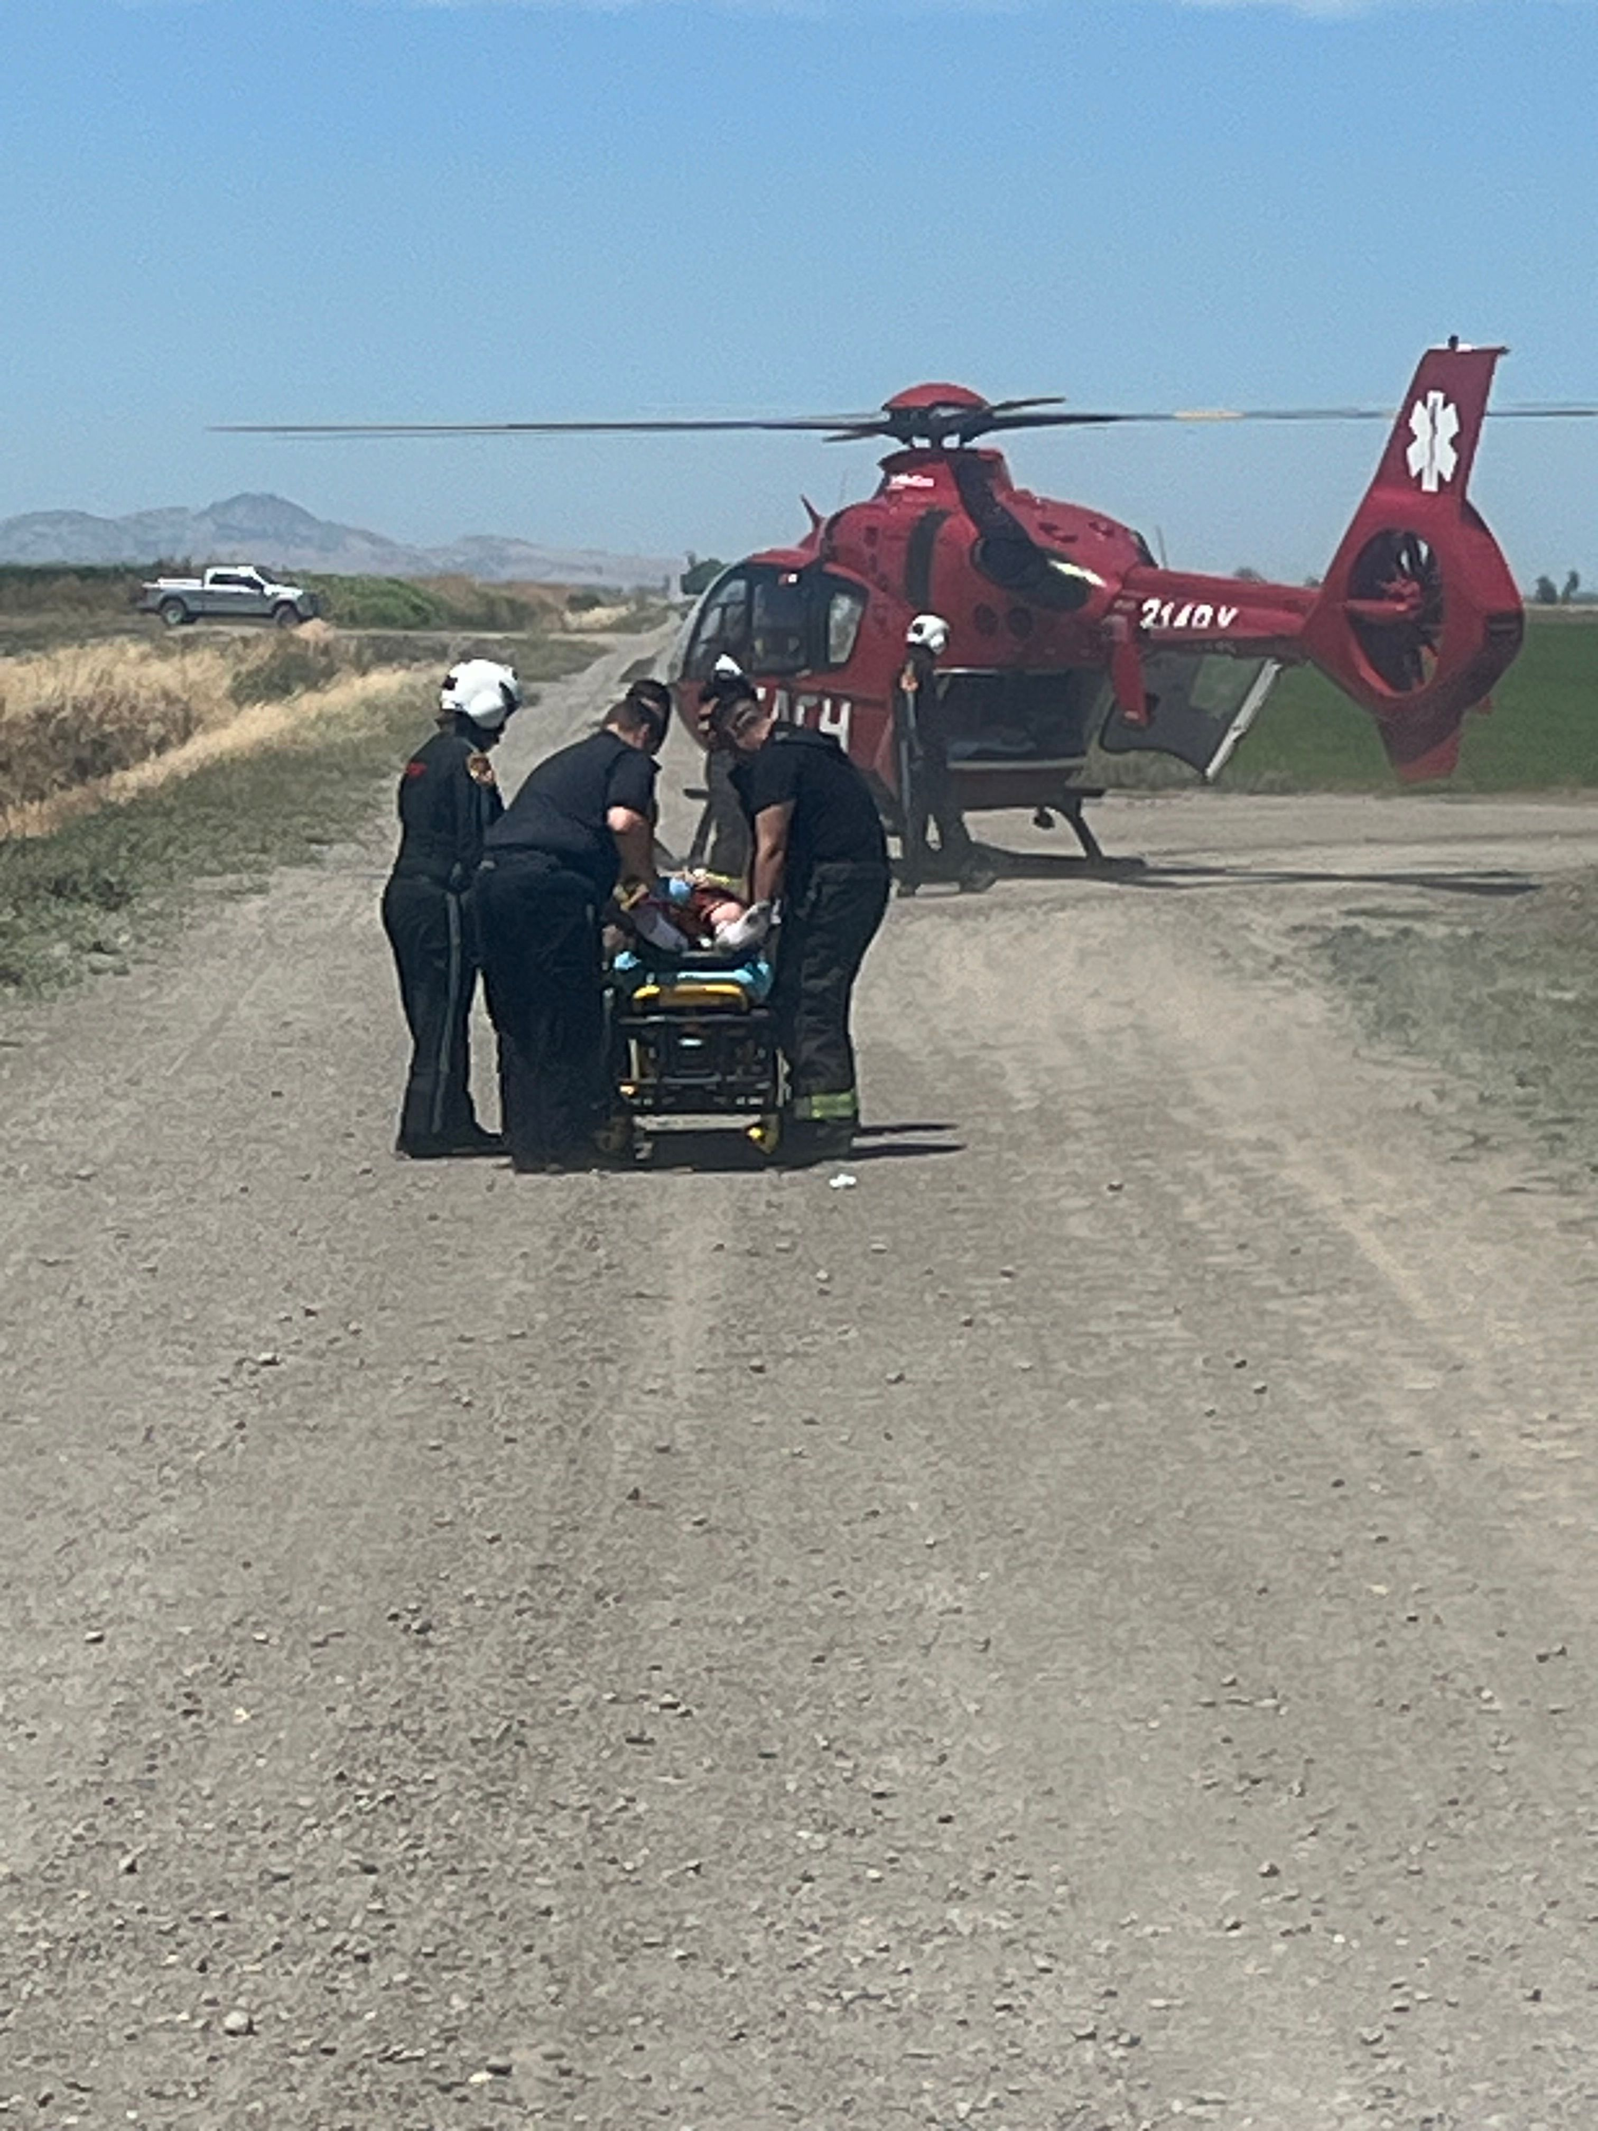
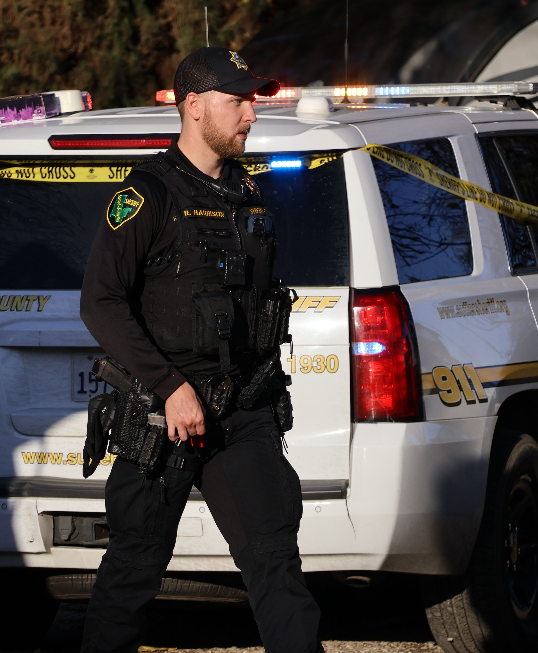
What Specifically Do State Takeaways do to Emergency Readiness?
Limited ability to replace equipment
Delayed facility improvements
Reduced capacity for training and retention
Increased strain on existing staff

Slide 9
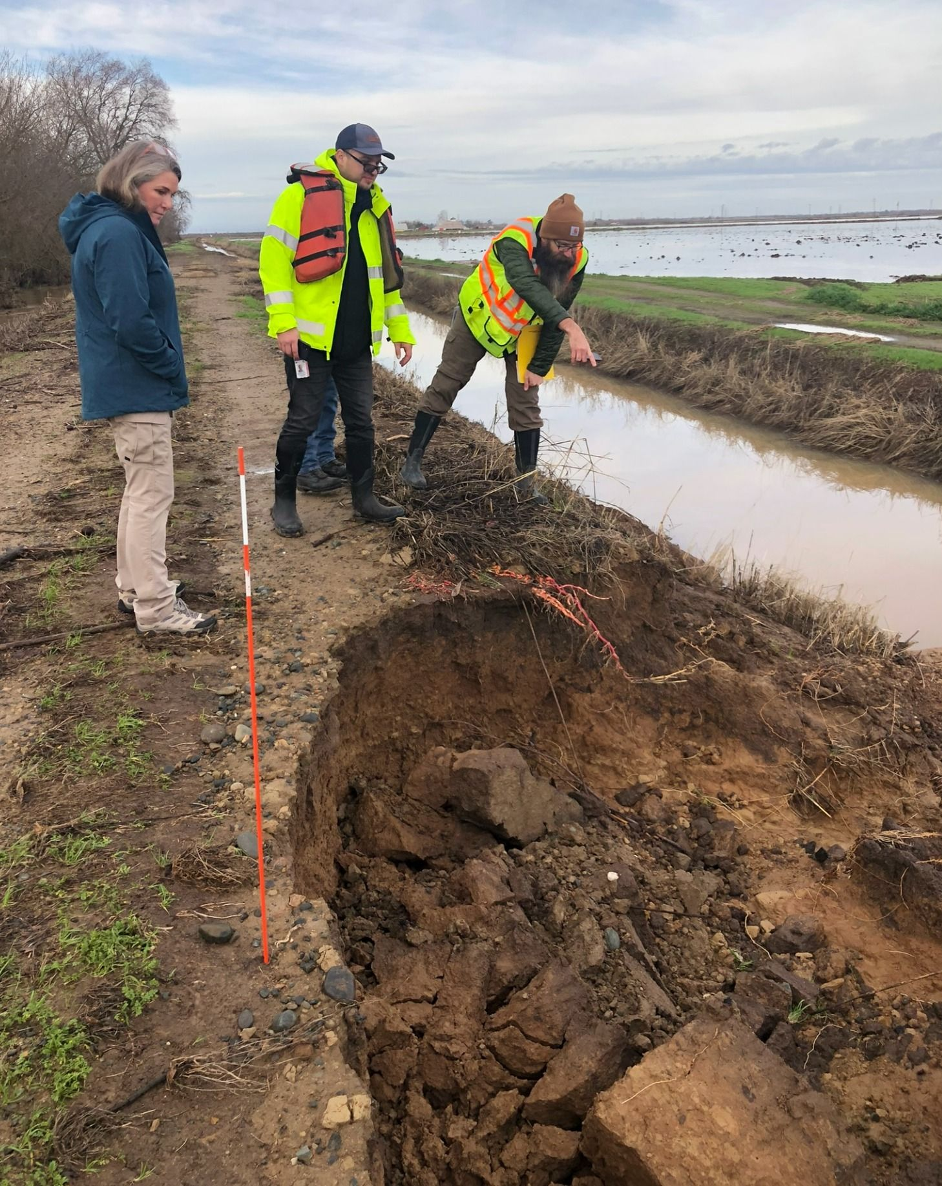
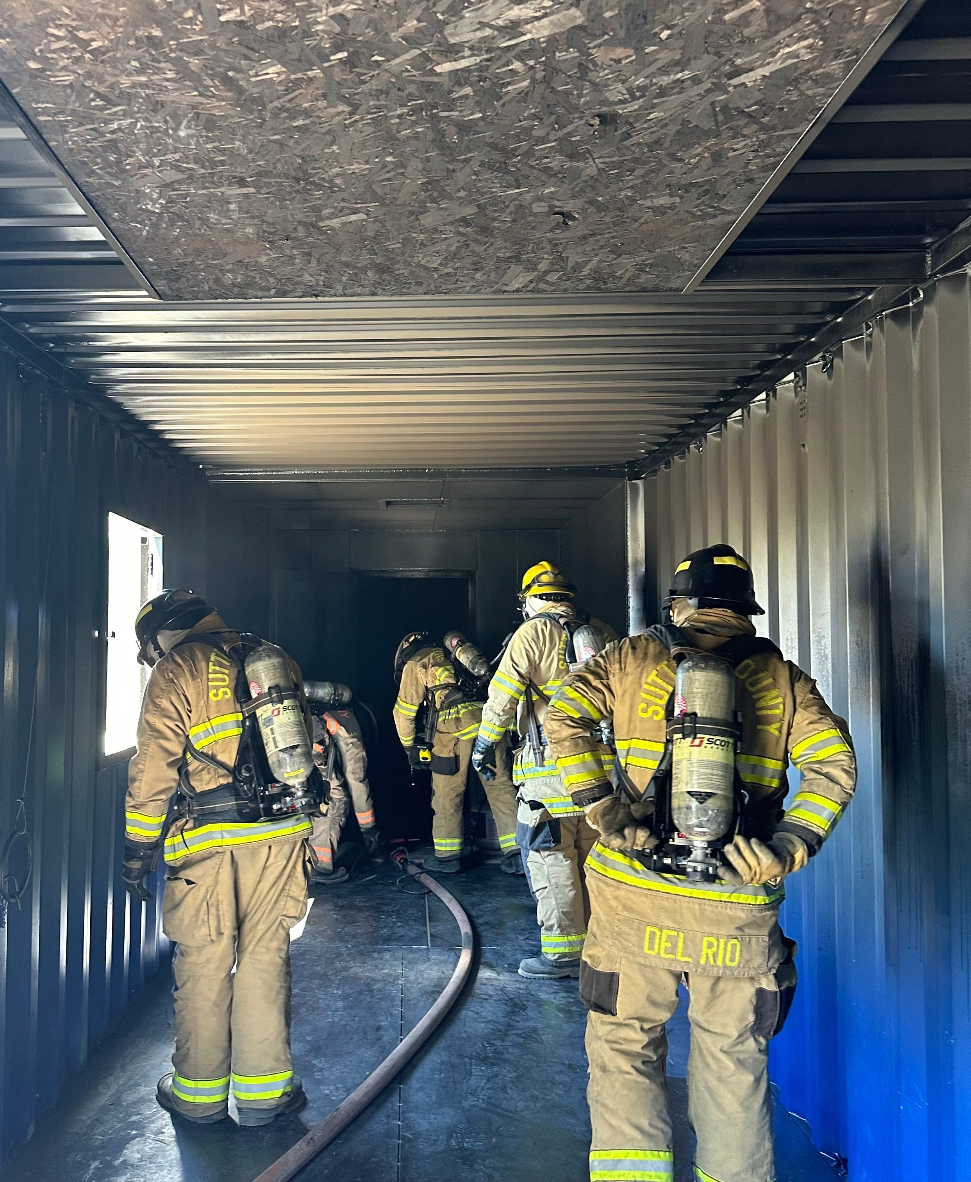
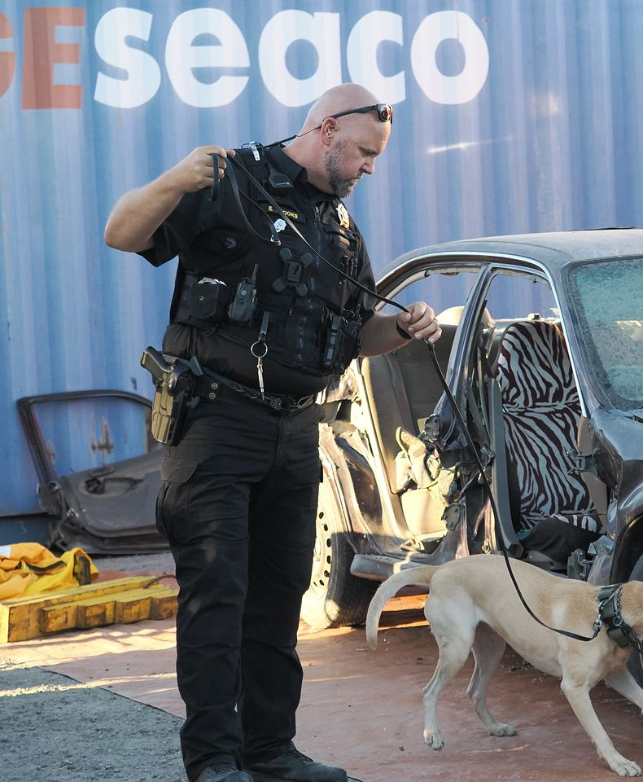
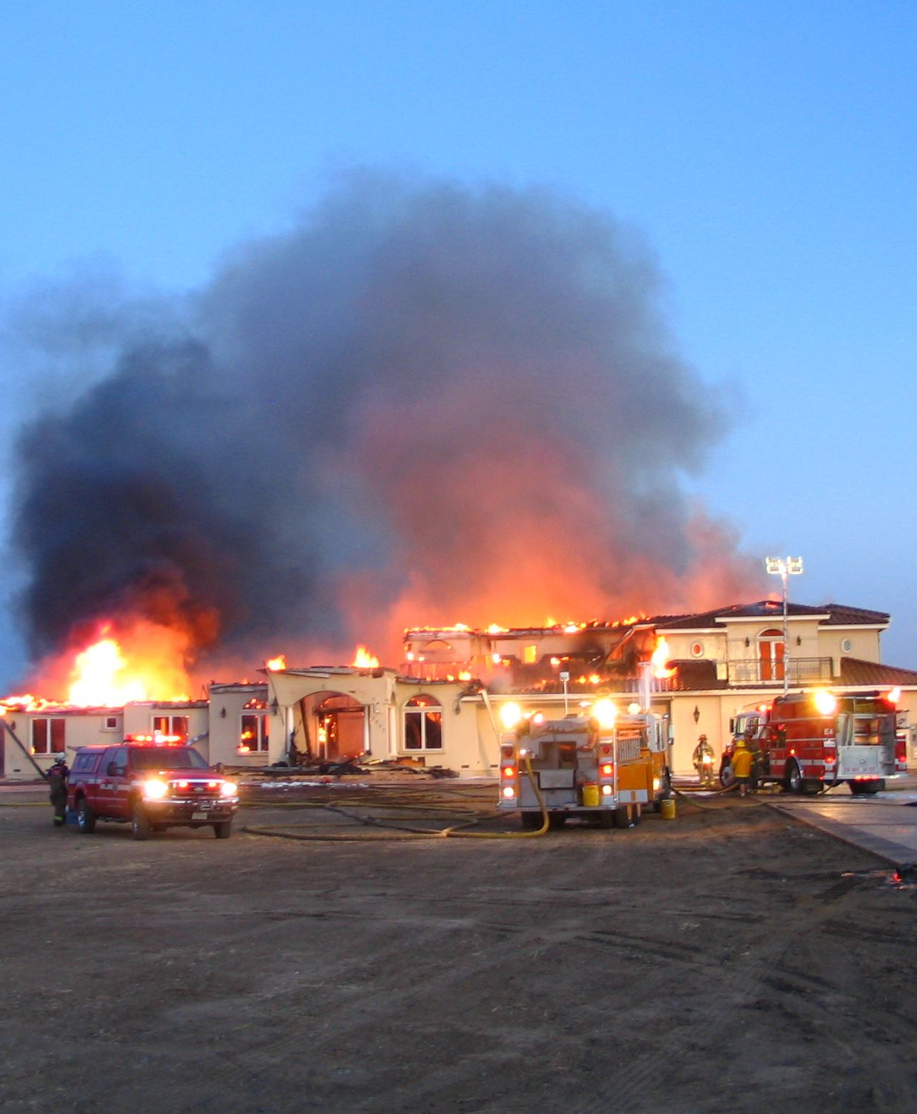
OUR Community Values
In a recently conducted community survey, Sutter County residents identified the following top priorities:
Ensuring adequate drinking water supplies
Repairing roads
Preventing fire and emergency medical response times from getting longer
Maintaining public safety, fire response times
Retaining experienced firefighters

Slide 10
Your Feedback Matters – Roadmap to A Safe, Self Reliant Sutter County
Take The Survey
Help Spread The Word
Help Spread The Word
Please visit www.Sutter.gov/conversation and join the conversation by completing an online community survey.
If you are a member of a community or civic organization, let us know if you would like the County to present at your next meeting.
Your feedback will help the County make decisions on its budget reconciliation this year.

Slide 11

Questions?

