Slide 1
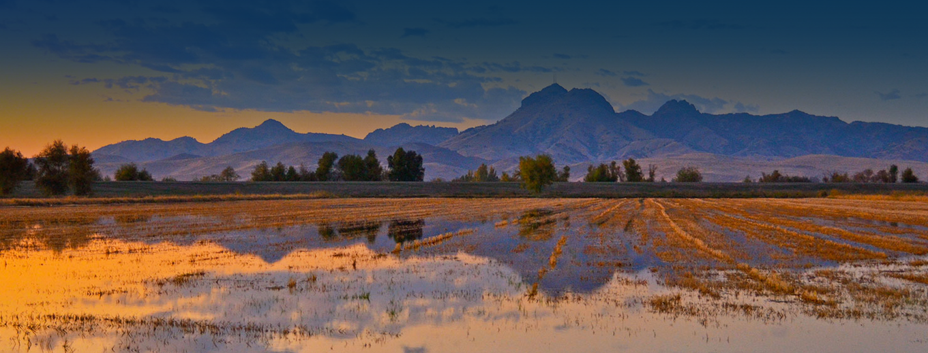



The Sutter County and Yuba City Conversation
A Safer, More Self-Reliant Region
z
Spring 2026

Slide 2



Community Conversation Matters!
z
Learn More
To maintain safety, services, and quality of life city and countywide, Sutter County, Yuba City and Live Oak need input on community priorities
Provide Input
Local government is listening to residents about their local service priorities - let us know what you care about most today!
Make a Difference
Your input will help inform next steps at the county and city levels.

Slide 3
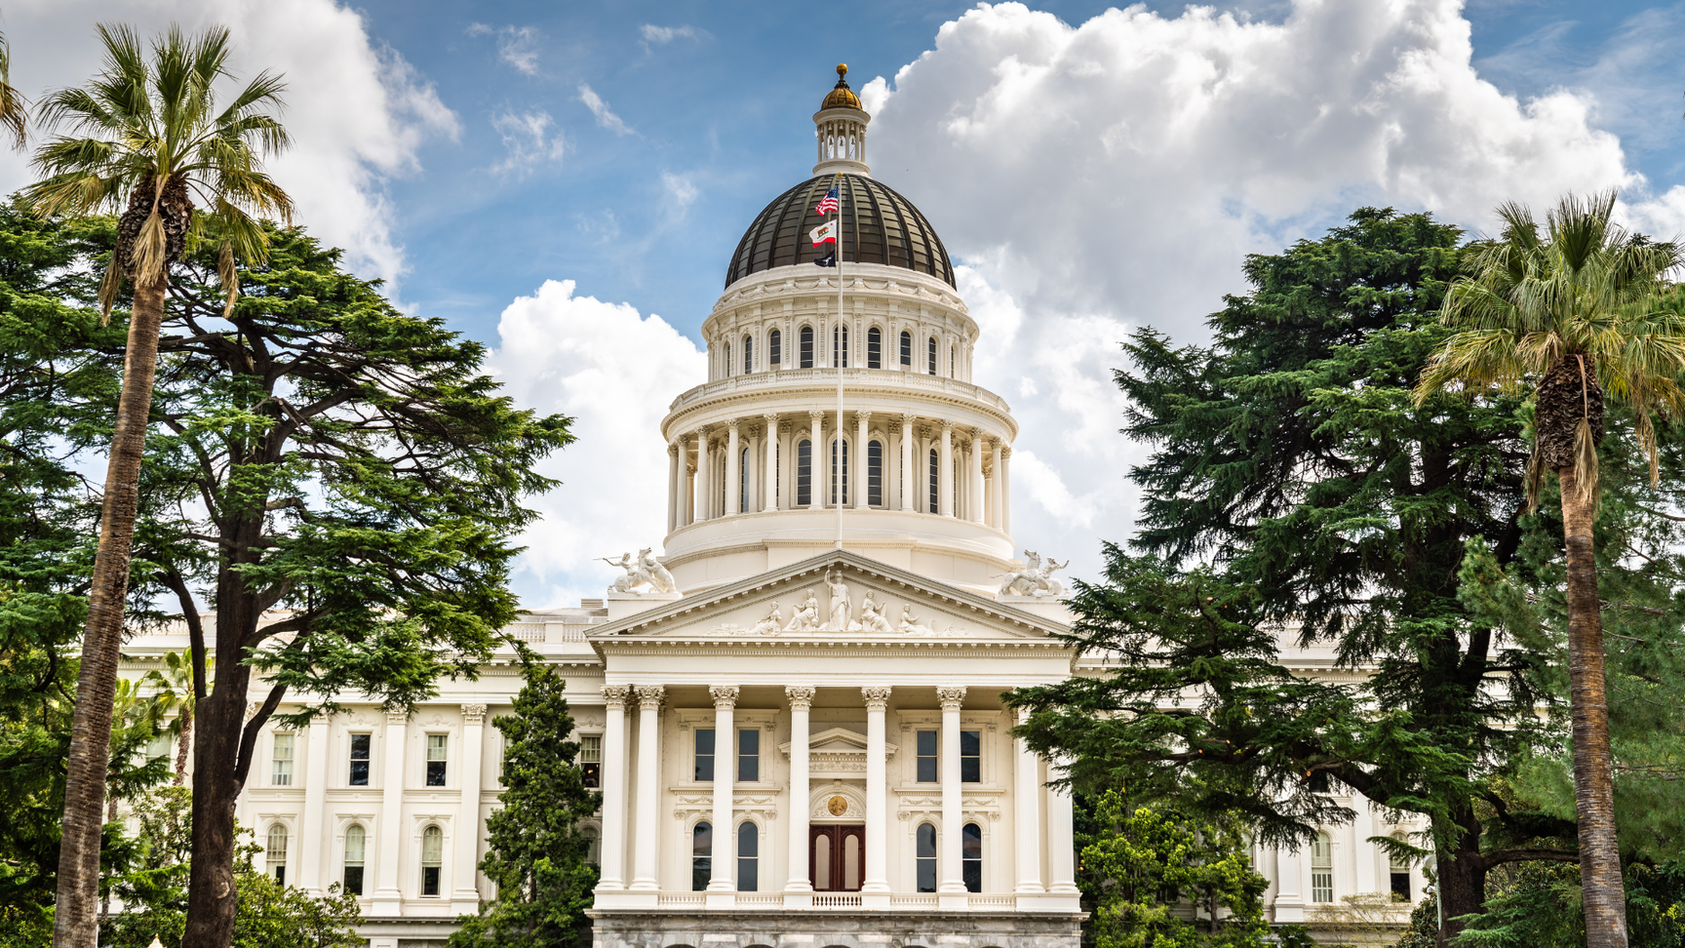
State/Federal Takeaways Threaten Public Safety
Sutter County region faces growing public safety demands for:
Safe streets
Safe neighborhoods
Safety from growing fire threats
State/Federal agencies continue taking funding from local governments
Resulting County/City budget cuts reduce public safety services and mutual aid
Our region cannot rely on the state and federal governments to keep us safe – we must rely on ourselves

Slide 4
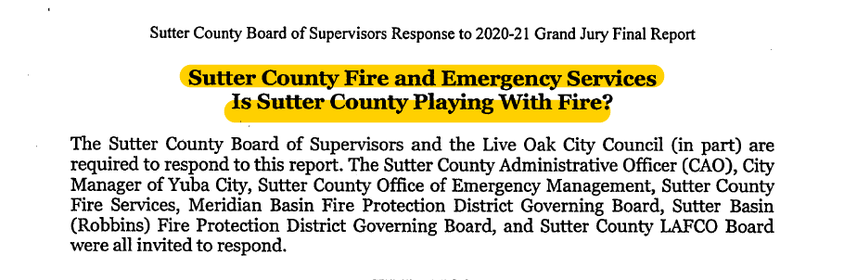
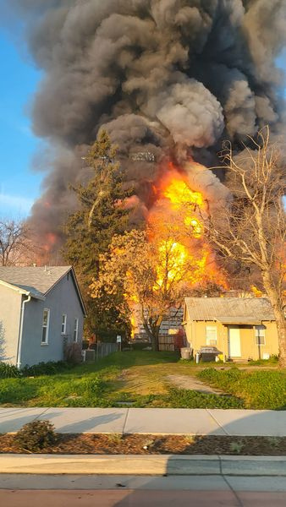
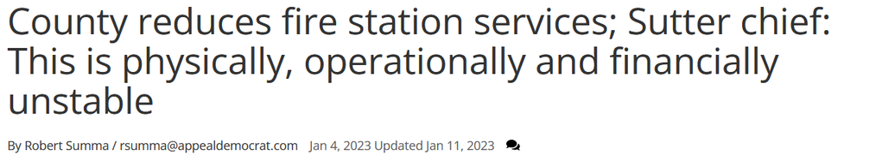
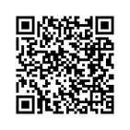
Threats to Fire Safety
2021 Grand Jury reported the County needs additional fire service funding to address:
Increased wildfire risk
Aging equipment and facilities
Staffing and retention challenges
Rising emergency response needs
Reduced ability to provide mutual aid
In 2023, the County was forced to make additional cuts to fire service funding
We want to hear from you

Slide 5
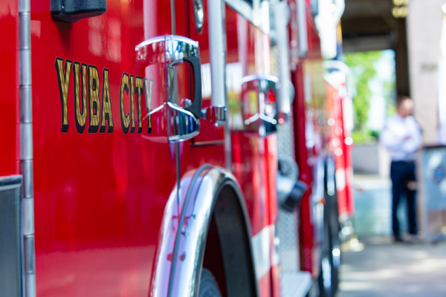
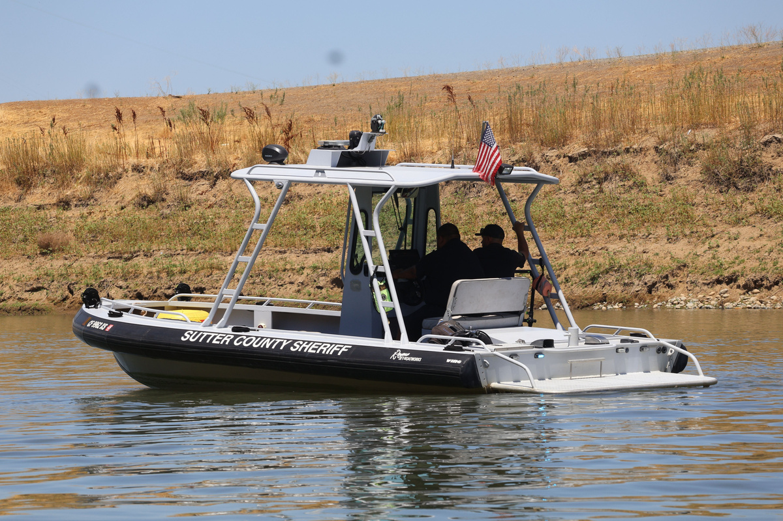
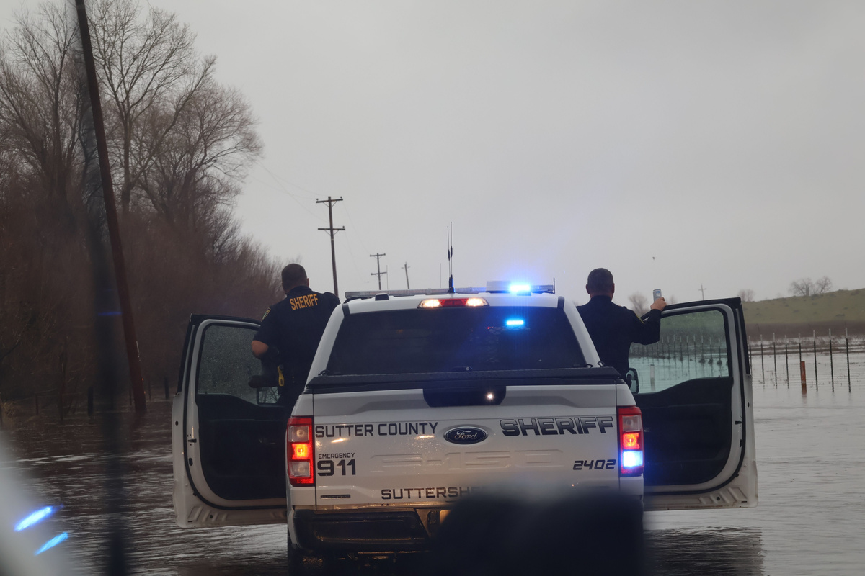
Threats to Rural Public Safety & Mutual Aid
z
Public safety services cross jurisdictional lines
Live Oak relies on County fire services
Yuba City and the County depend on mutual aid for fire and police
In Yuba City, some fire stations are too small for modern fire trucks and don’t have up-to-date, lifesaving medical & firefighting equipment
Rural public safety is also compromised:
At times, only three County Sheriff’s deputies are on patrol for 600 square miles.
Large patrol areas = longer response times

Slide 6
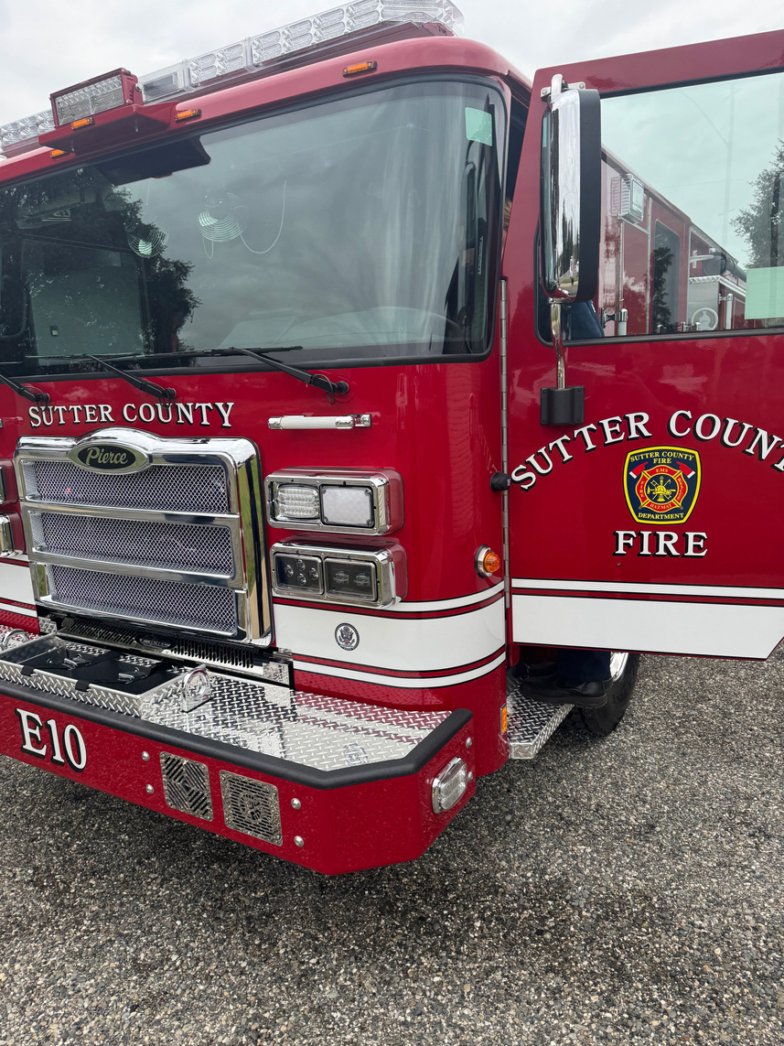
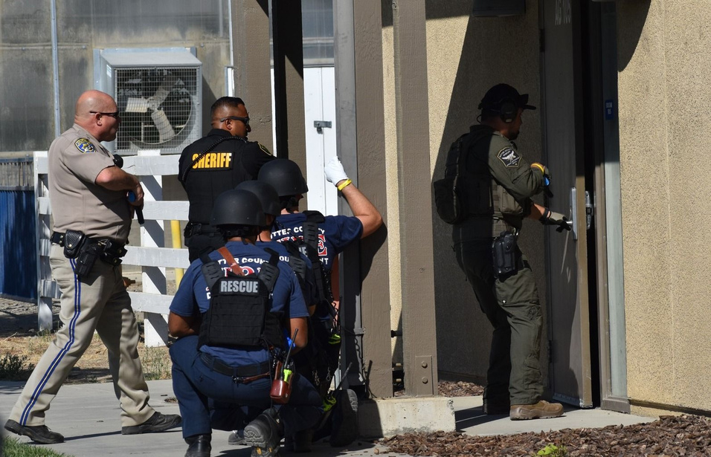
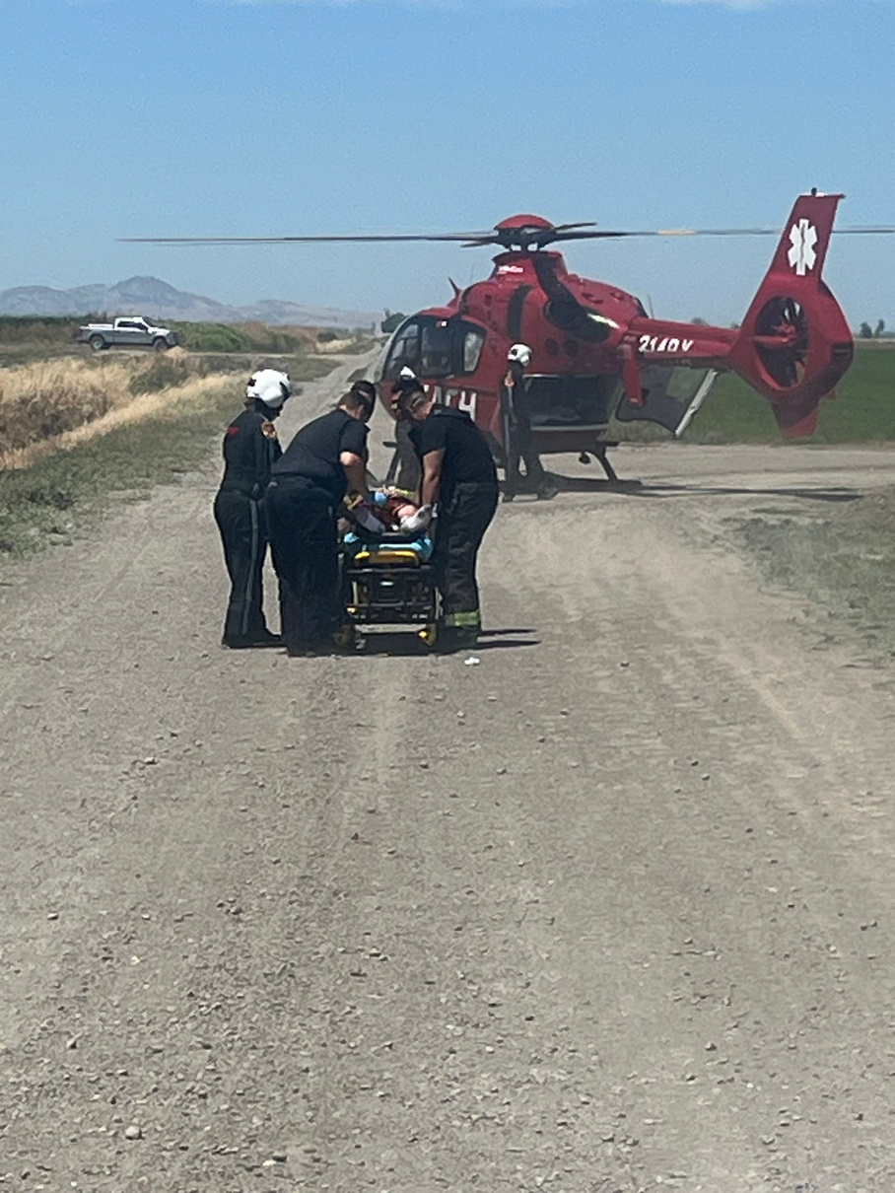
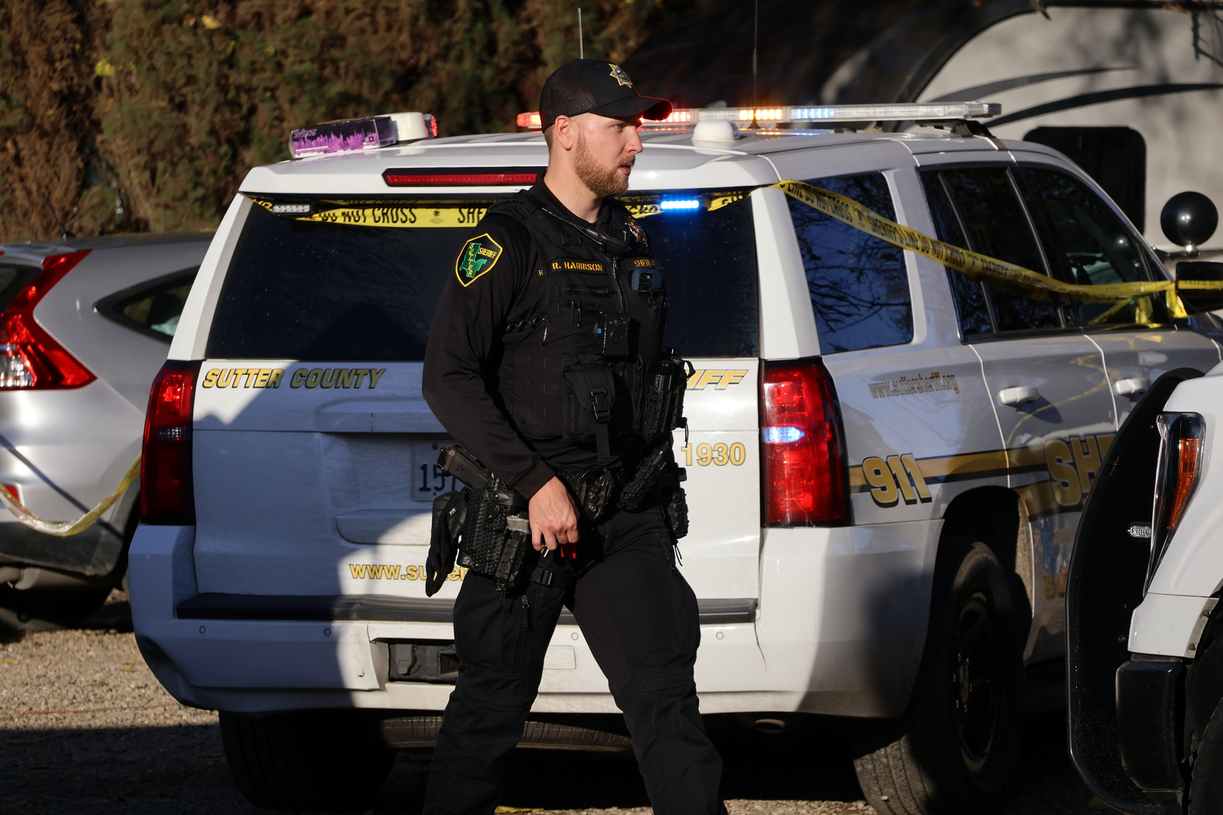
Threats to Emergency Readiness
Limited ability to replace equipment
Delayed facility improvements
Reduced capacity for training and retention
Increased strain on existing staff
Large patrol areas, especially in rural regions
Longer response times to 911 sheriff/police calls
Limited ability to improve coverage
We want to hear from you

Slide 7
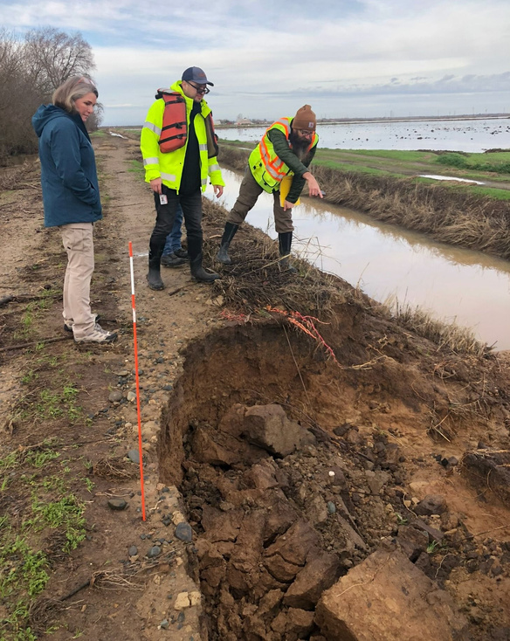
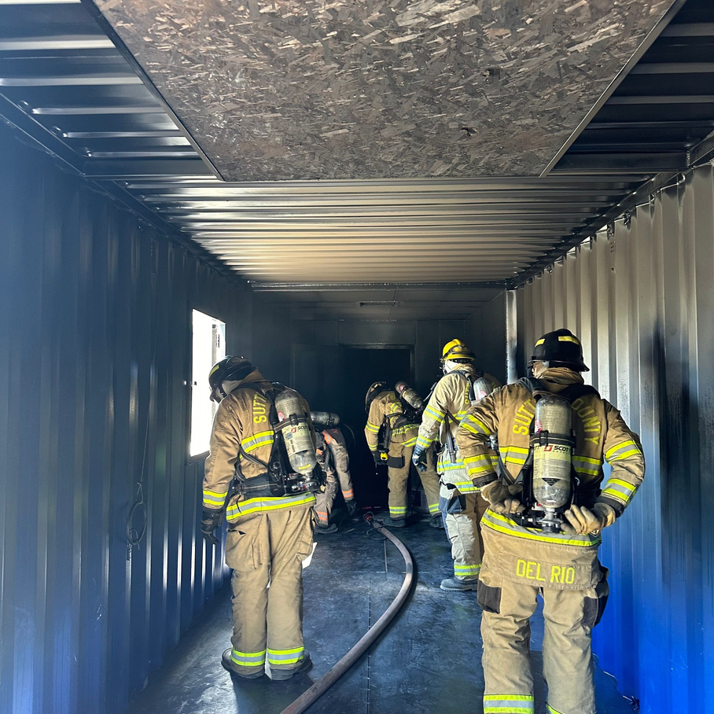
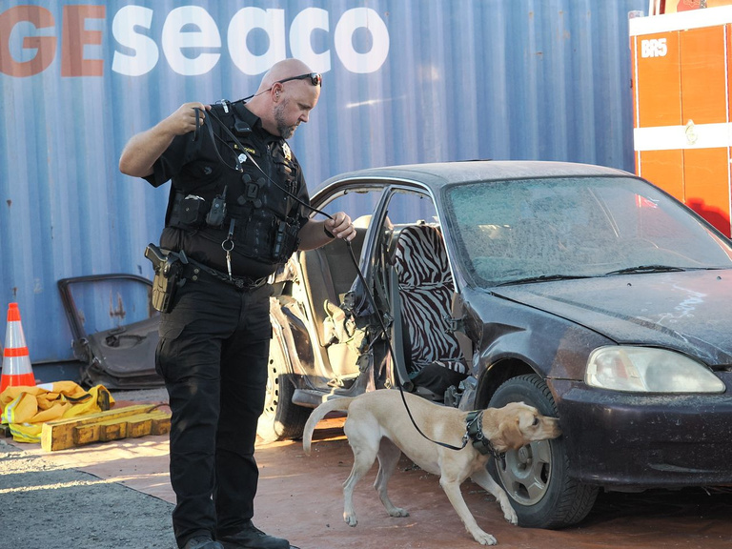
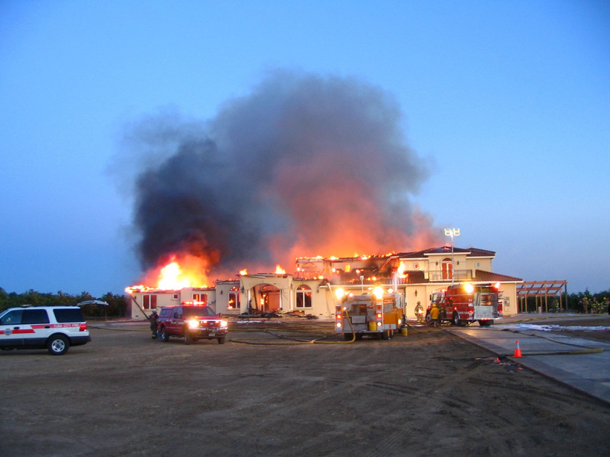
State/Federal Takeaways Threaten Community Priorities
In a recently conducted community survey, Sutter County residents identified the following top priorities:
Ensuring adequate drinking water supplies
Repairing roads
Maintaining fire and emergency medical response times
Retaining experienced firefighters
We want to hear from you

Slide 8



Your Feedback Matters to a Safe,
Self-Reliant Sutter County
Take The Survey
Spread The Word
Make a Difference
Please visit www.Sutter.gov/conversation and join the conversation by completing an online community survey.
If you are a member of a community or civic organization, let us know if you would like the County to present at your next meeting.
Your feedback will help the County make decisions on its budget reconciliation this year.

Slide 9

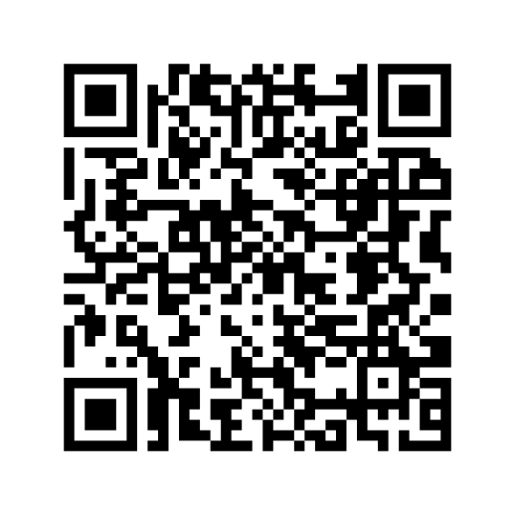
Join the Conversation:
If you are a member of a civic organization that would like an additional presentation, contact Kathy DeMille at kdemille@co.sutter.ca.us

